Slide 1
2025 Digital Columbus Project
Development of digital innovation technologies for rapid prediction of potential complex disasters and continuous disaster prevention
Complex Disaster Management System - JAVIS(Joint Autonomous Resilience Virtual Intelligent System)
Development of a hierarchical agentic AI-based digital twin platform for complex disaster prediction and response
2025.03
AI  Digital Twin Research Center
Dong-A University

Slide 2

01
Project Necessity
02
Project Goals
03
Project Strategy and Organization
04
Appendix

Slide 3
Key
Complex Disaster
Disaster Impacts Model*
Pre-impact
conditions
Emergency management interventions
Hazard mitigation
Hazard preparedness
Recovery
preparedness
Hazard exposure
Physical vulnerability
Physical impacts
Social
impacts
Social
vulnerability
Hazard
event
Improvised
Disaster
response
Improvised
Disaster
recovery
Event-specific conditions
* source: Disaster studies, Michael K Lindell(2013), Sage Journals

Slide 4

01
Project Necessity
Complex disaster response platform for knowledgeable, trusted, autonomous, intelligent digital twins for federated data, real-time forecasting, and rapid operations.

Slide 5
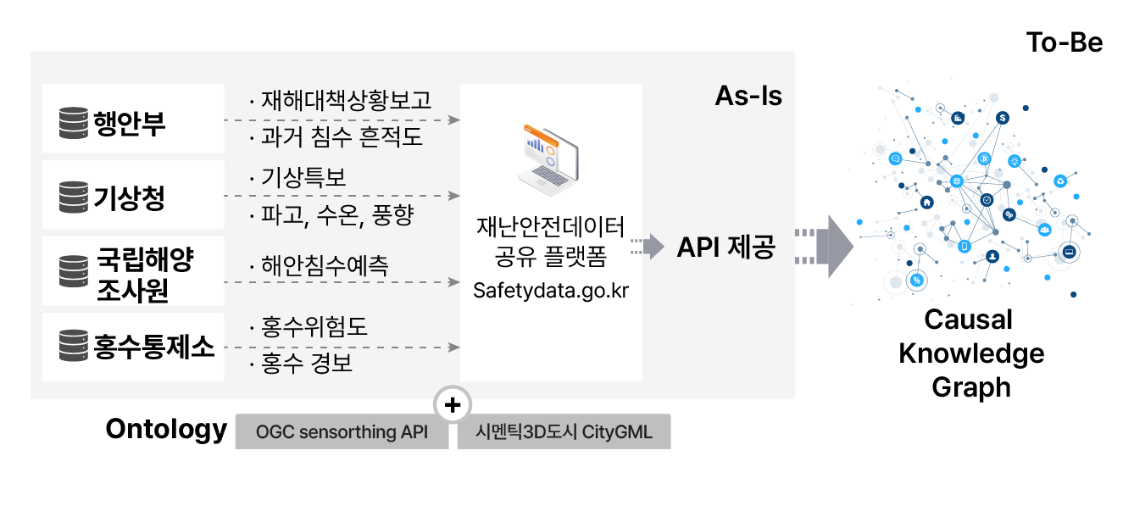
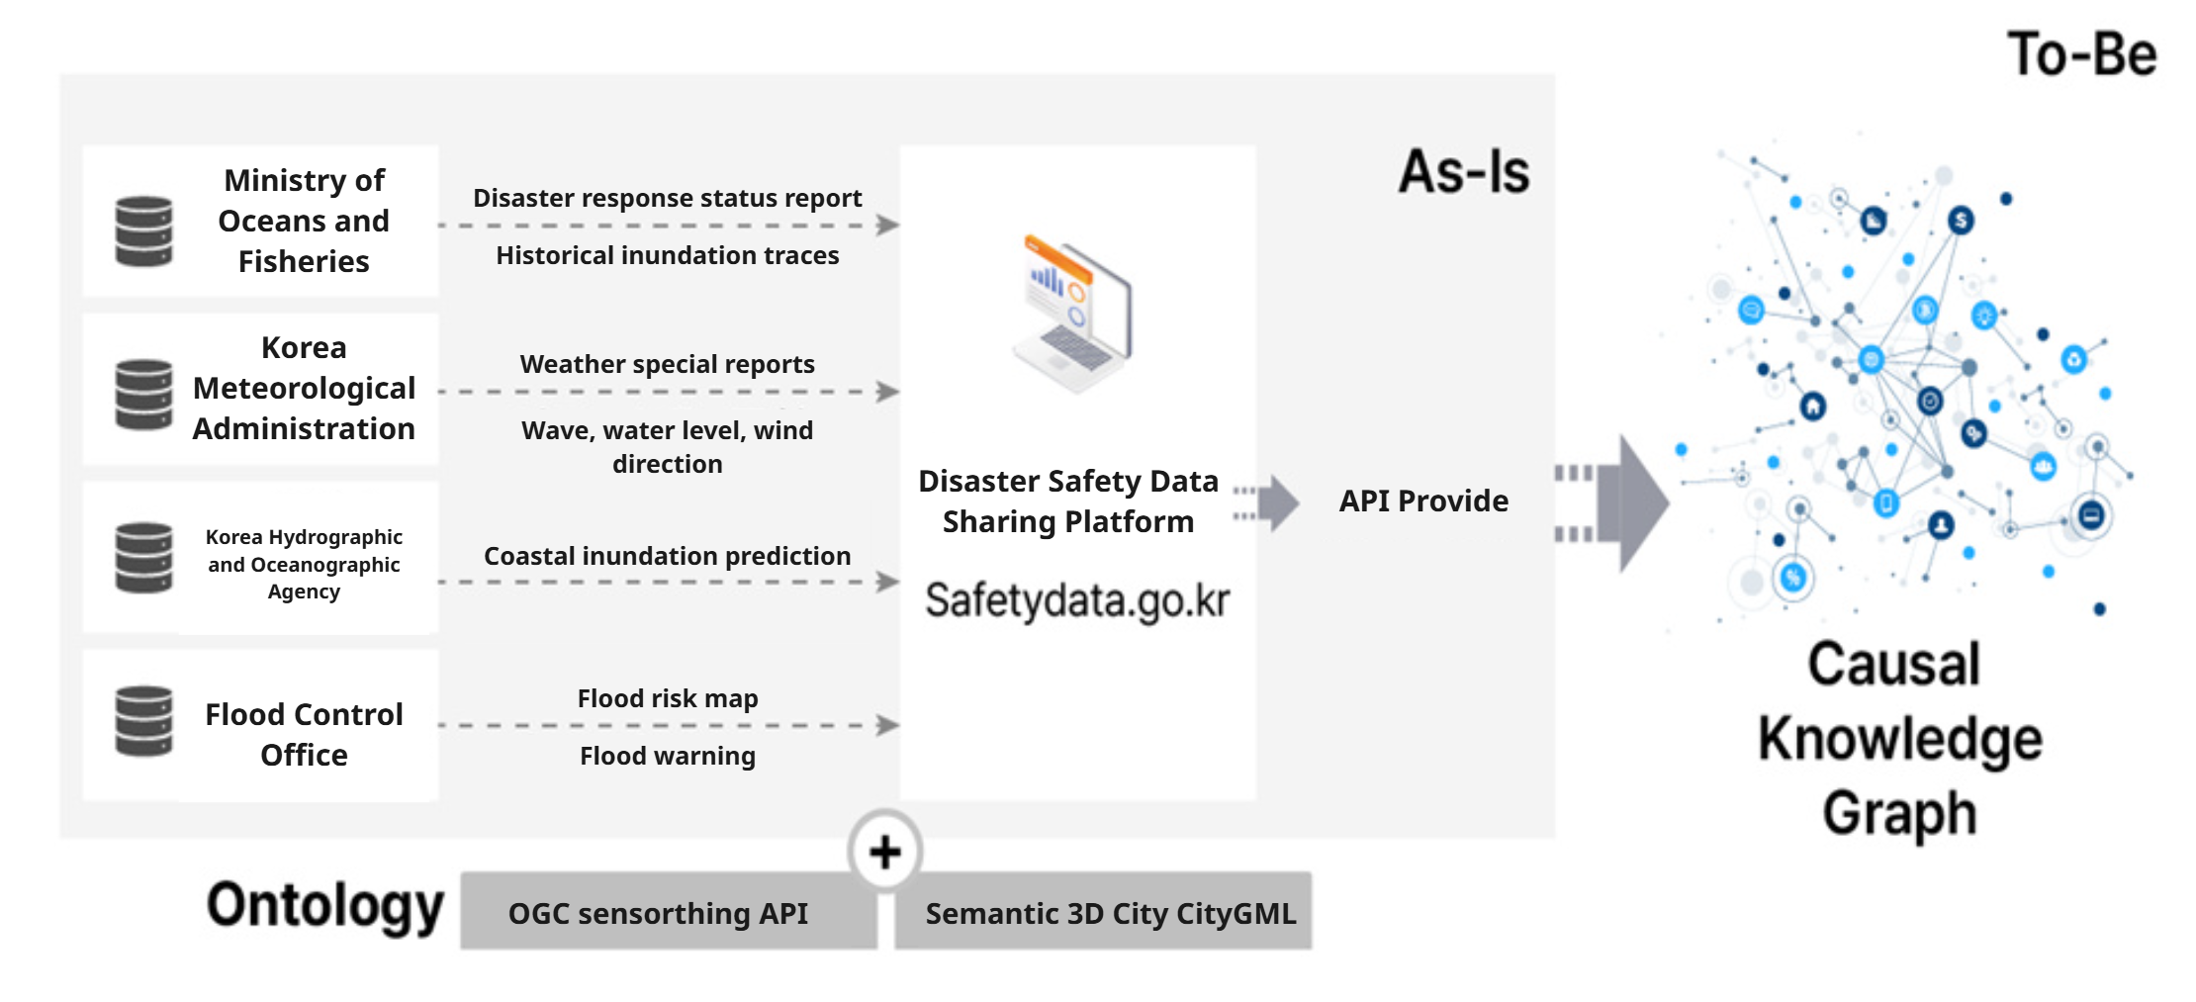
01
The R&D Challenges
복합재난 예측∙대응을 위한 계층적 Agentic AI 기반
디지털 트윈 플랫폼 개발
1-1
The demand for R&D challenges
[The demand for R&D challenges]
Complex disasters require knowledgeable, trusted, autonomous, intelligent digital twin complex disaster response platforms for fused data, real-time predictions and rapid operations
❶ Knowledgeable complex disaster data
· It is essential to effectively integrate various data for human-level disaster understanding and decision-making.
· Multi-source information, such as weather, satellite, and traffic data. Knowledgeization with Fusion Data by Disaster Type (Ontology - Knowledge Graph)Technology
Disaster Safety Data Sharing Platform

Slide 6
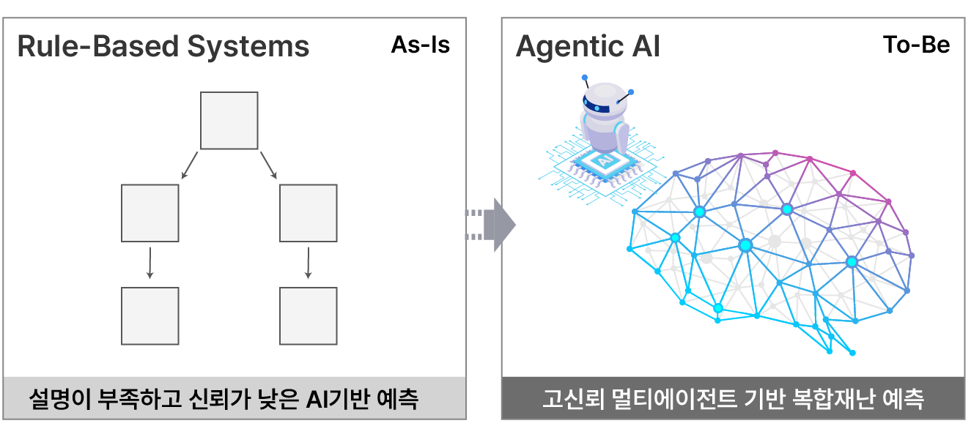
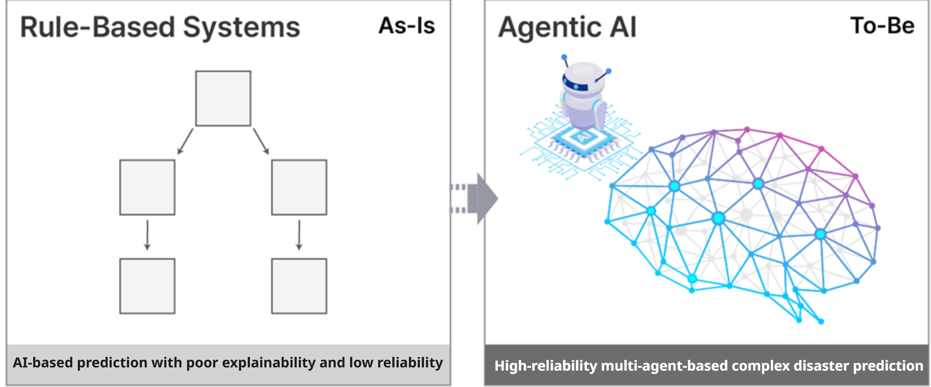
01
The R&D Challenges
복합재난 예측∙대응을 위한 계층적 Agentic AI 기반
디지털 트윈 플랫폼 개발
1-1
The demand for R&D challenges
[The demand for R&D challenges]
Complex disasters require knowledgeable, trusted, autonomous, intelligent digital twin complex disaster response platforms for fused data, real-time predictions and rapid operations
❷High-confidence multi-agent-based complex disaster prediction
· Predicting future based on the likelihood of complex disasters and simulating various scenarios.
· Ensuing high reliability through extensive simulation and modeling based on digital twin technology.

Slide 7
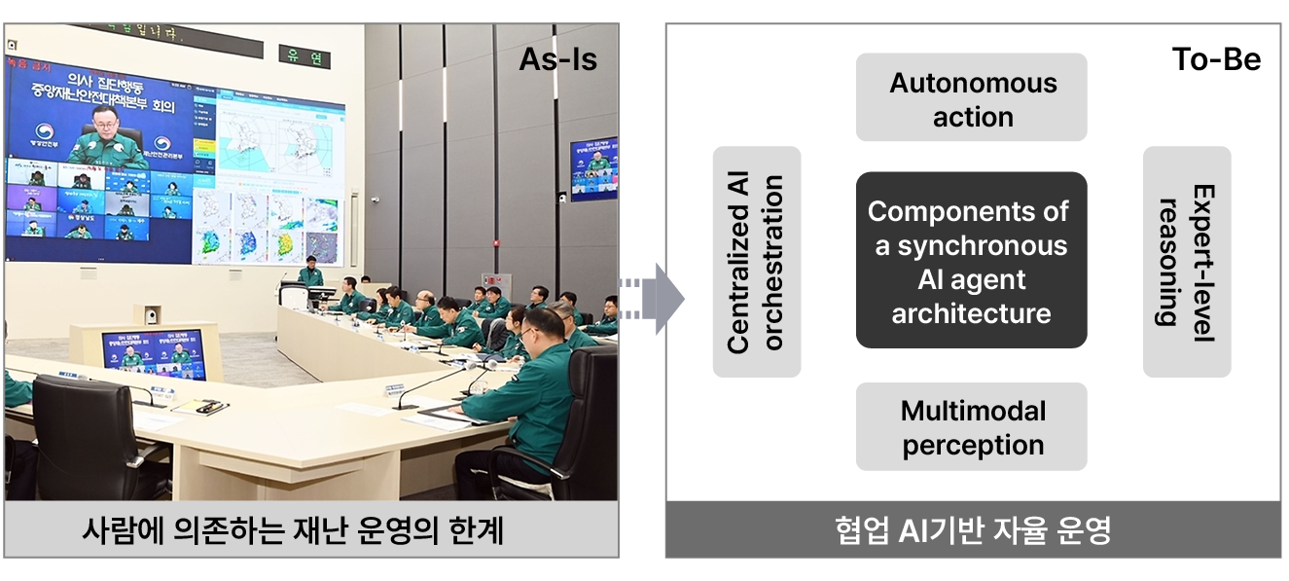
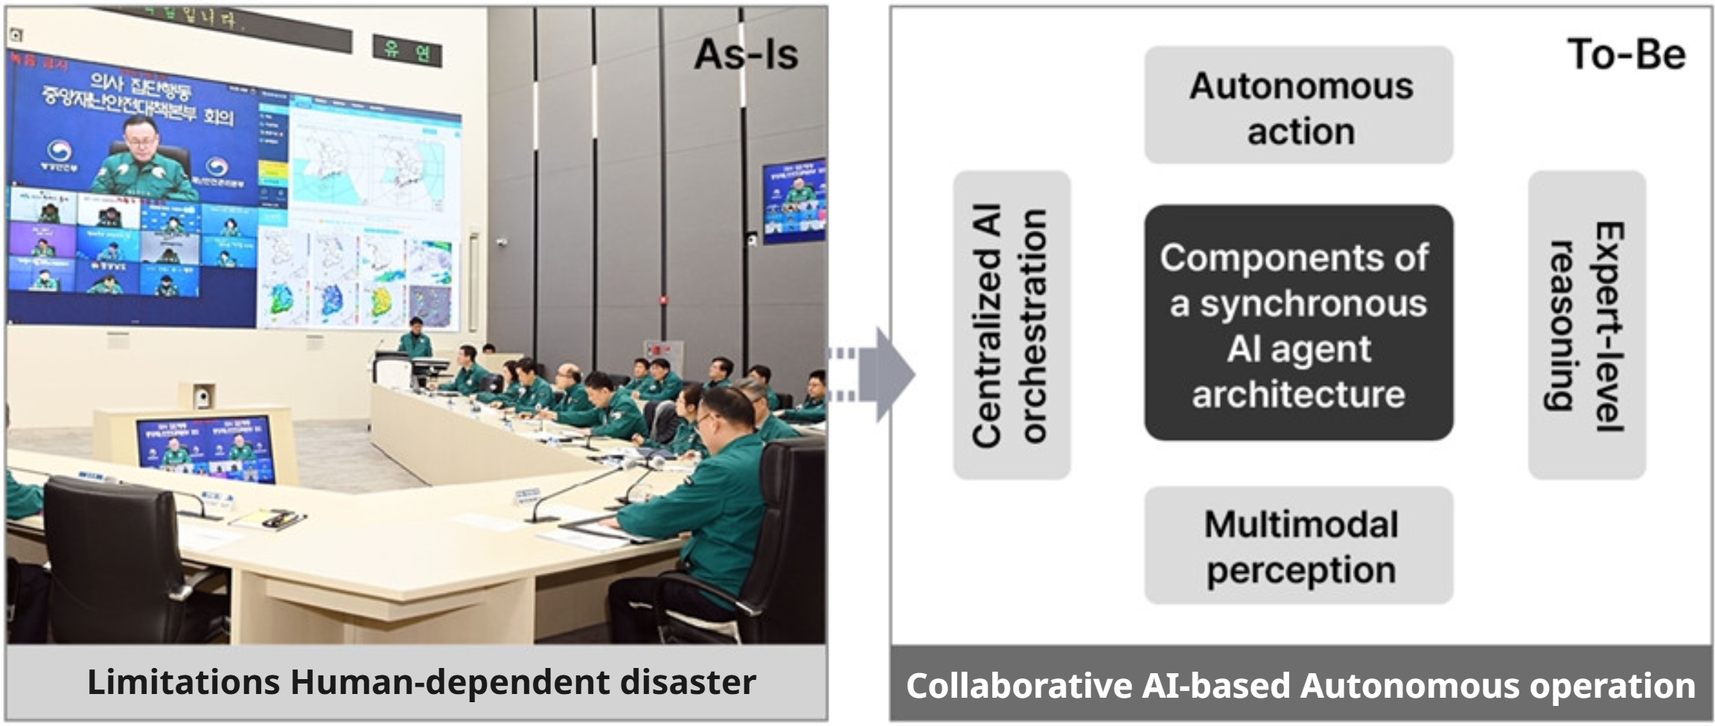
01
The R&D Challenges
복합재난 예측∙대응을 위한 계층적 Agentic AI 기반
디지털 트윈 플랫폼 개발
1-1
The demand for R&D challenges
[The demand for R&D challenges]
Complex disasters require knowledgeable, trusted, autonomous, intelligent digital twin complex disaster response platforms for fused data, real-time predictions and rapid operations
❸ Collaborative agentic AI-Based autonomous operation
· Limitations of fragmented and inefficient decision-makling based on human resources.
· Agentic AI-based autonomous operation technology enables rapid, accurate, and collaborative disaster risk minimization.

Slide 8
02
Objectives and contents of research and development projects
Development of a hierarchical agentic AI-based digital twin platform for complex disaster prediction and response
Complex Disaster Management System - JAVIS (Joint Autonomous Resilience Virtual Intelligent System)

Slide 9
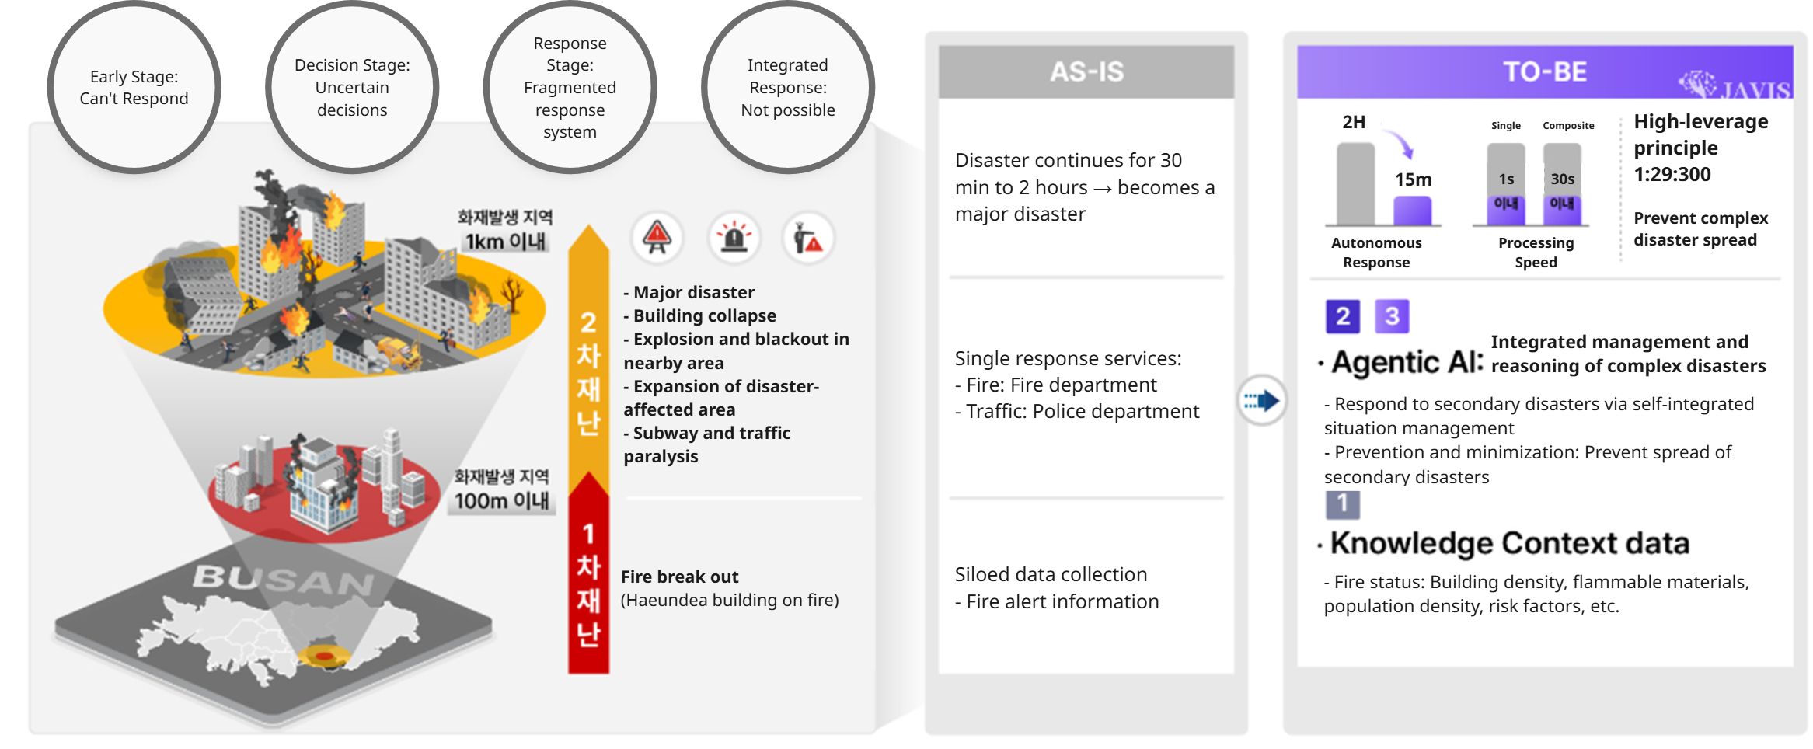
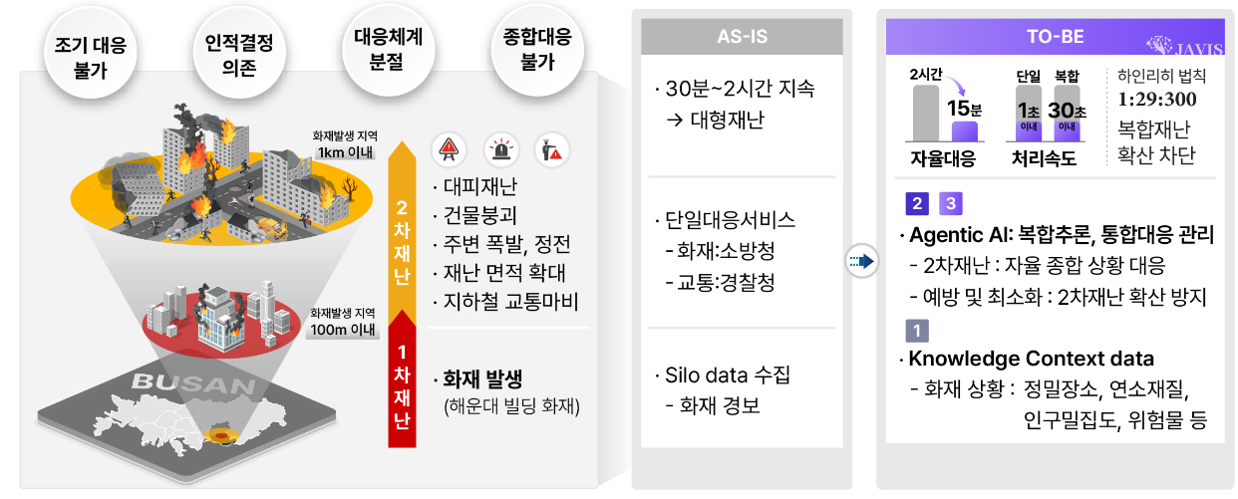
02
Goals and Content of R&D Project
복합재난 예측∙대응을 위한 계층적 Agentic AI 기반
디지털 트윈 플랫폼 개발
2-2
Goals, Objectives, and Outcomes of the R&D Project
On fire
With 1km
2nd Disaster
On fire
With 100km
1st Disaster

Slide 10
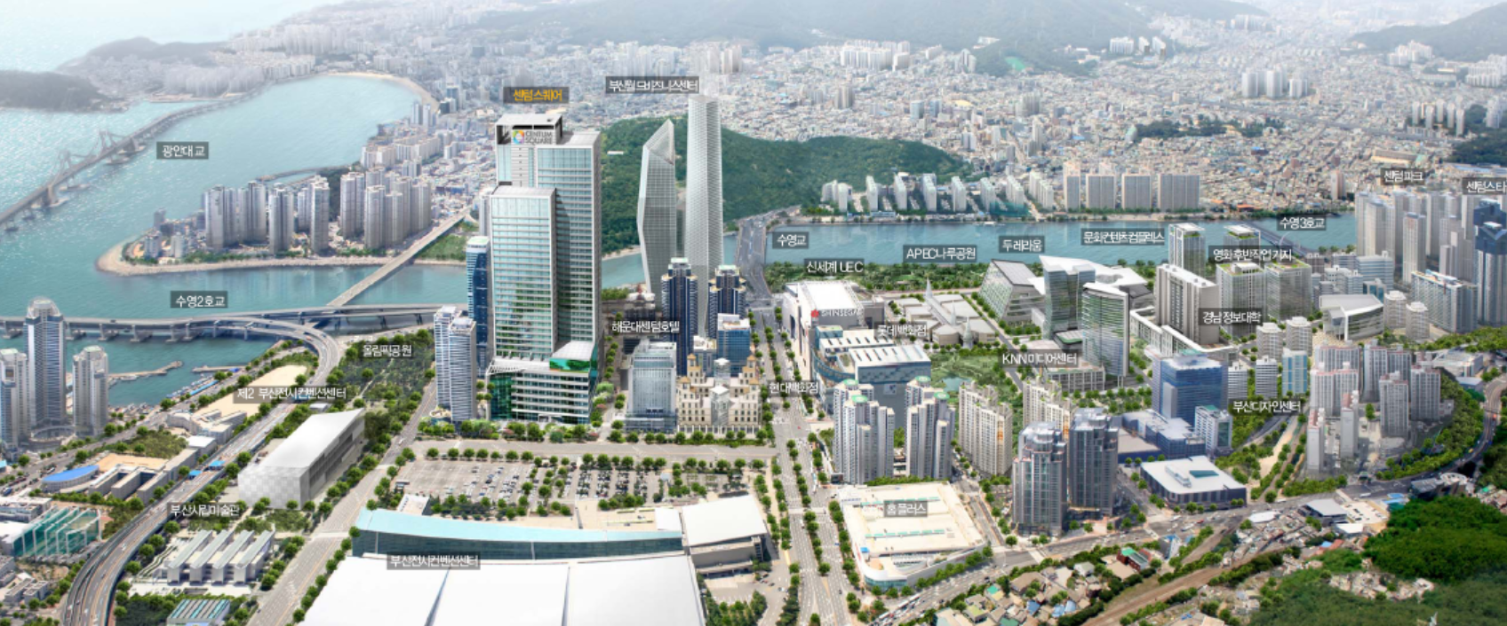



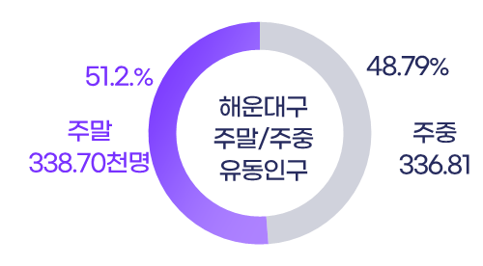

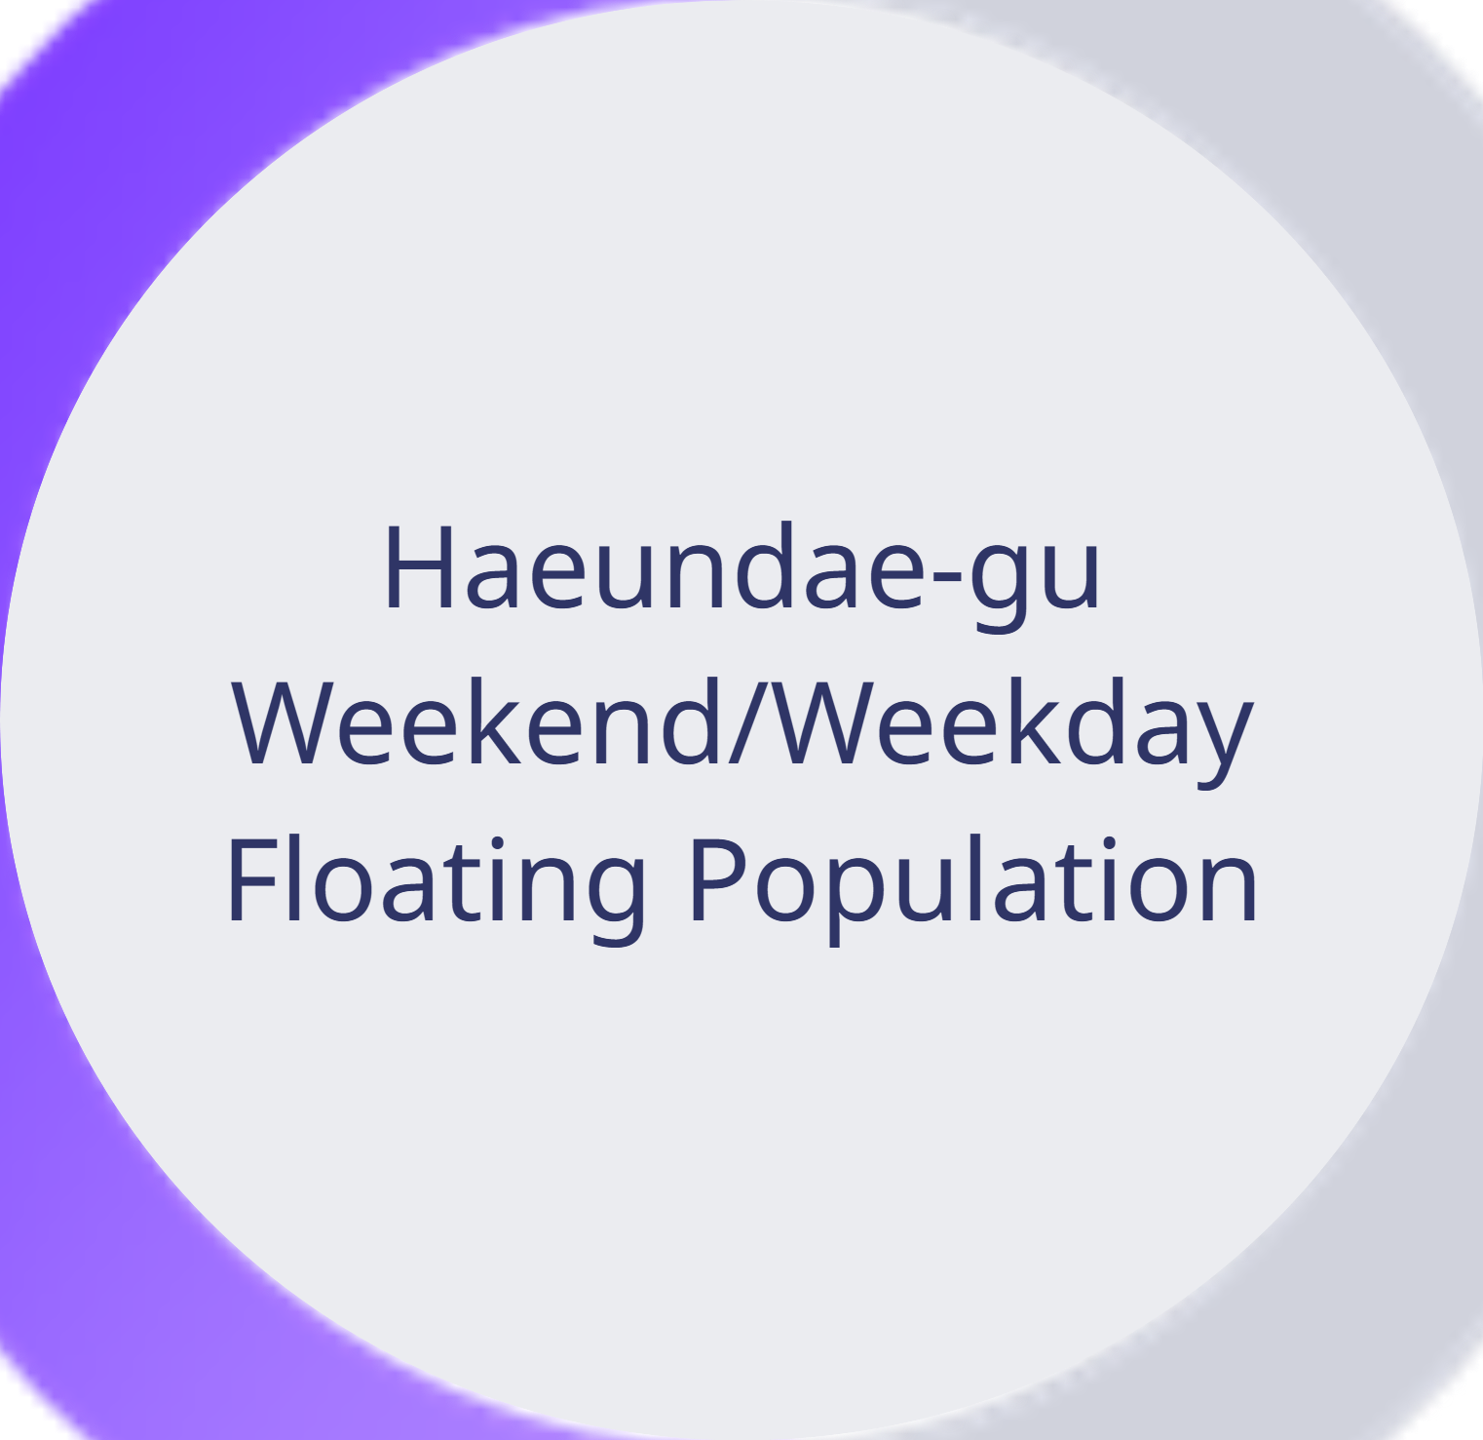
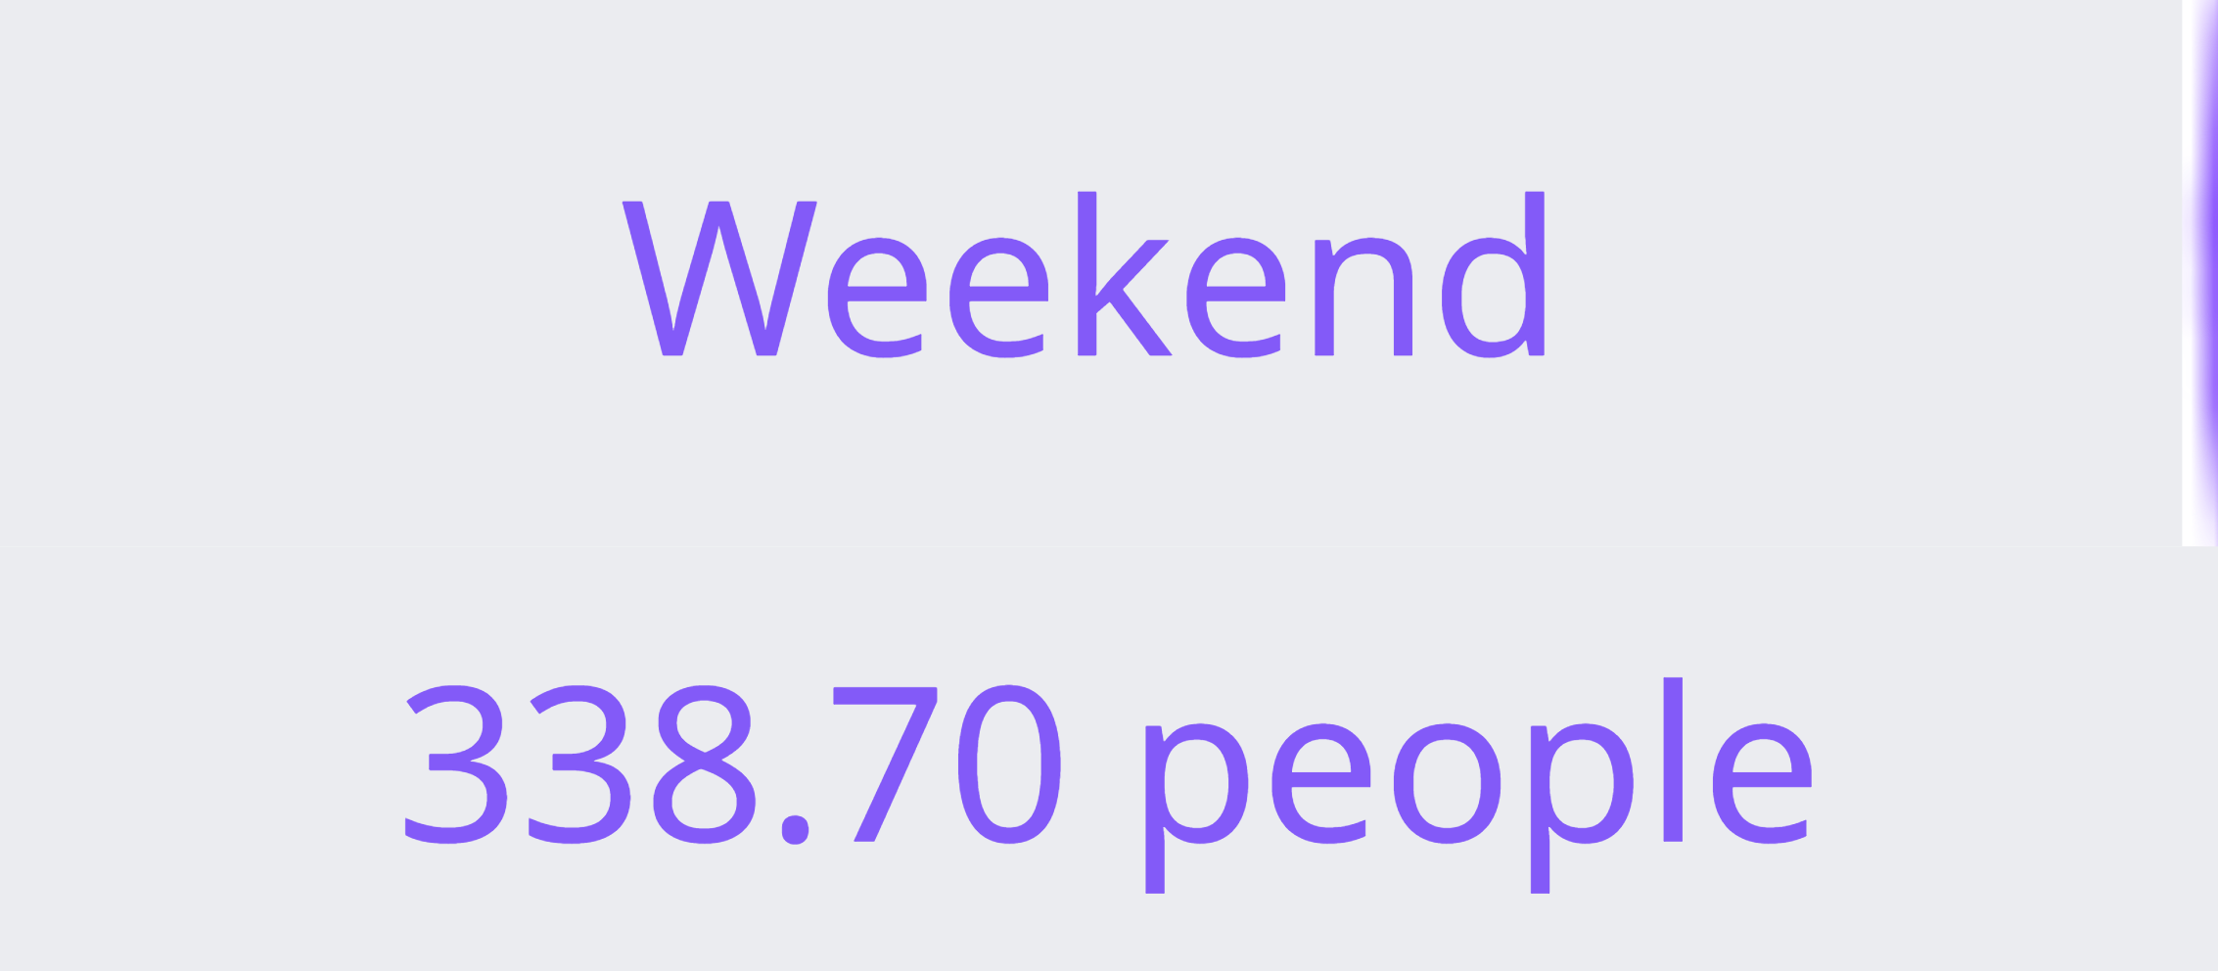
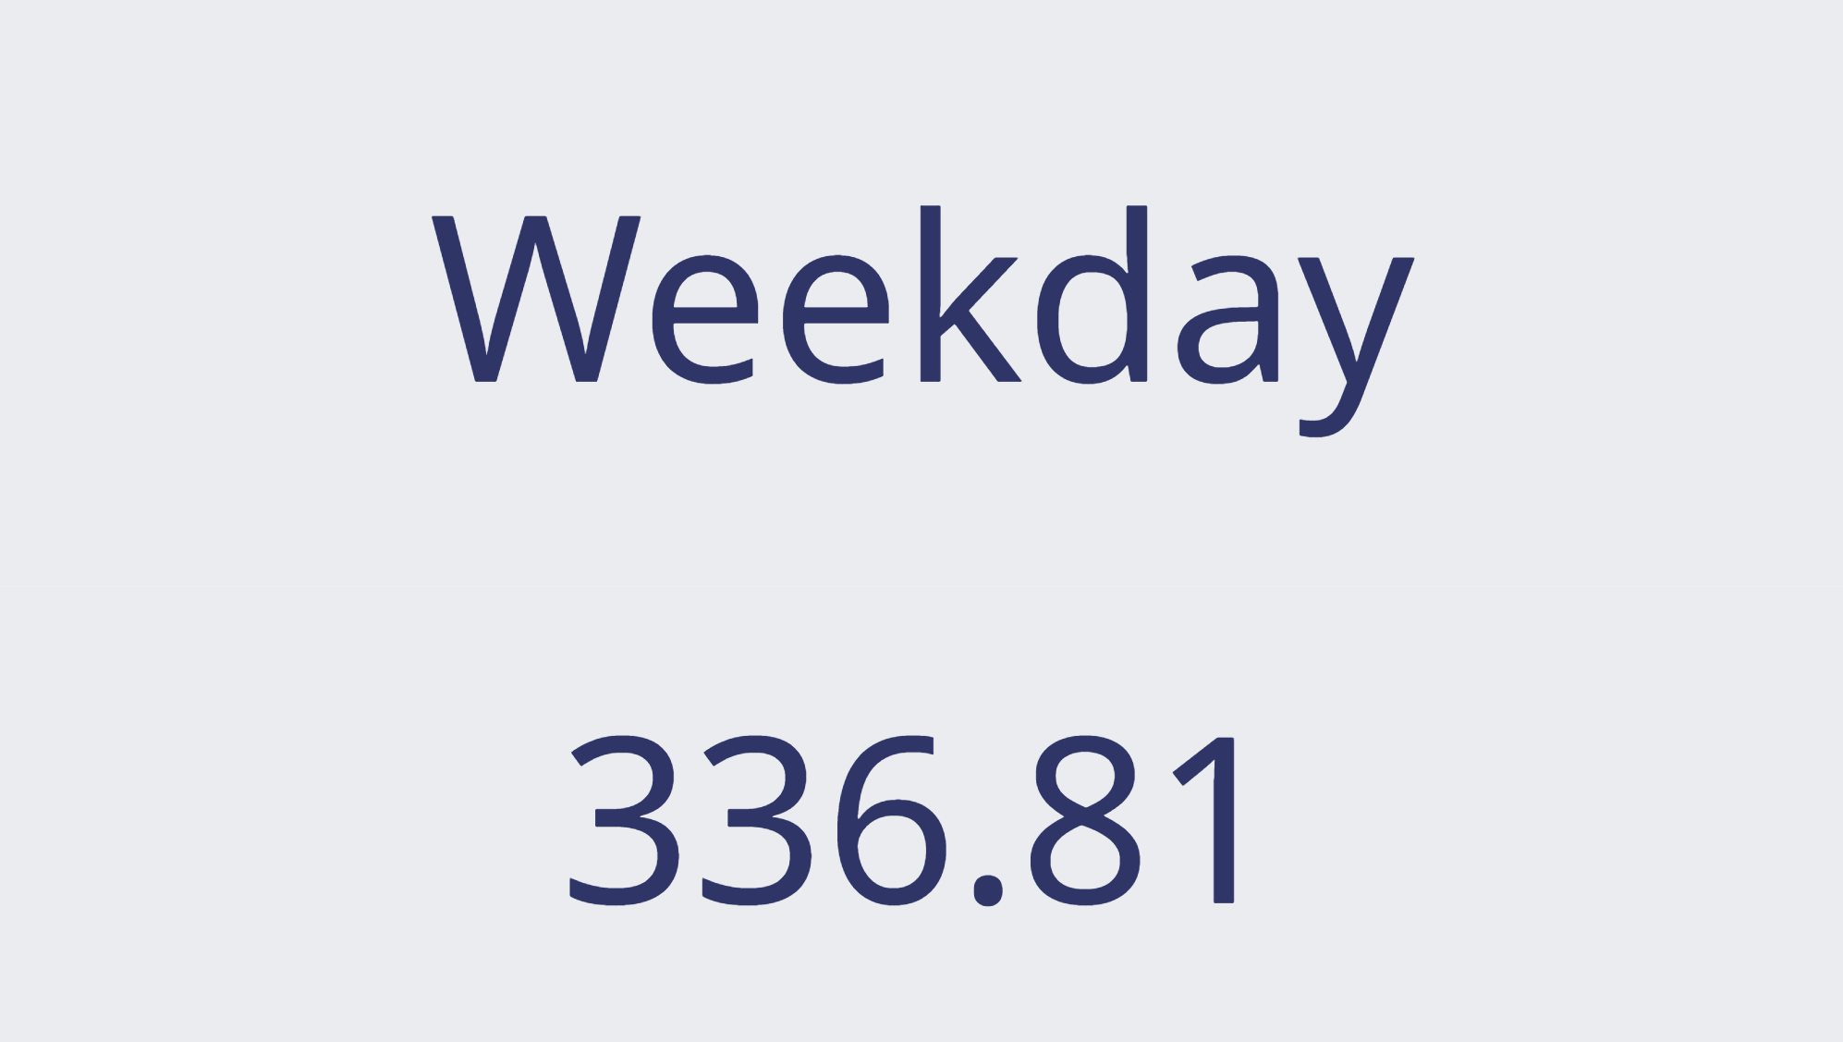
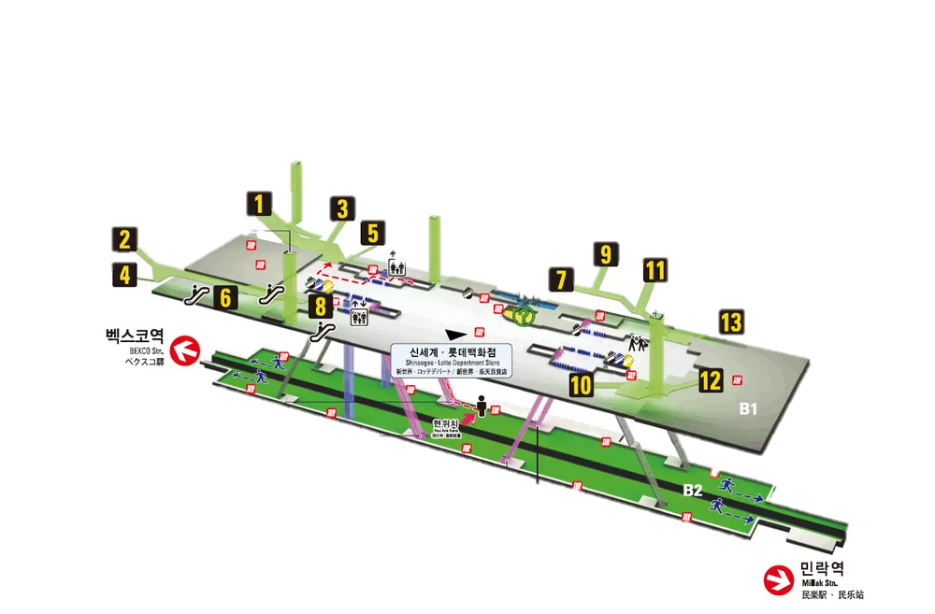
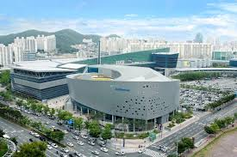
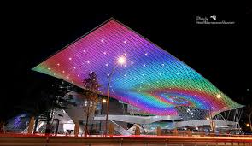
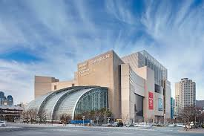
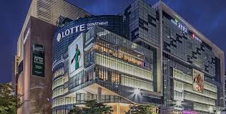

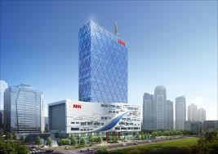
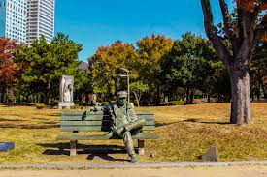
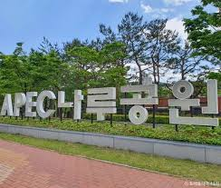
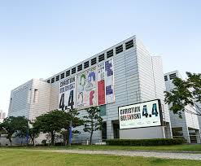
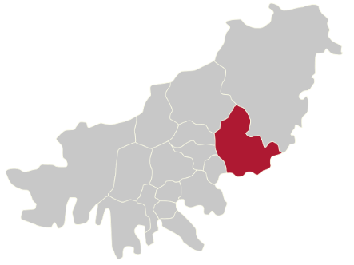

Complex Disaster Scenario
Busan Subway Fire Accident Expected Respone Strategy
SPOT
Busan Centum City
29,585 people (’24.12)
5.19 million(’as of 23y)
U2Dong Population
Centum City Center Population
Haeundea-gu Population
Ranked #1 in living population among all districts in Busan Metropolitan City
58,843 people(’23.12)
Subway daily(3.54%)
Daily boardings and alightings at Centum City and Bexco stations
BEXCO
Movie Theather
Shinsegae
Mall
Shinsegae
Mall
Major
Landmarks
Busan Centum City
KNN
Olympic Park
APEC Naru Park
Busan Museum of Art
High-Tech Industrial Park
On the banks of the Suyeong River in Haeundae-gu, Busan (350,000 pyeong) a high-tech complex industrial complex with functions such as information and communication, video, entertainment, and international business.
Life
Work
Primary Resisdences: Centum Star, Trump World Centum I, Worldmark Centum, WBC The Palace, Forrena Centum City
Main Office: Busan Information Industry Promotion Agency, Busan Design Center, Busan Creative Economy Innovation Center, DIO Headquarters, etc

Slide 11
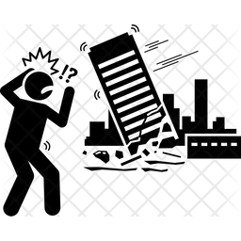


Complex Disaster Scenario
Busan Subway Fire Accident Expected Respone Strategy
Scenario
Subway Fire based Multiple Disaster
13:30
Collapse of High Rise Building
12:00
Fire Spreads
On Large Scale
Due to building wind effect, fire spreads to high-rise buildings.
Congestion worsens due to lunchtime crowd
Full closure of Centum City area
12:30
High-Rise Buildings Begin to Collapse
Fire in apartment complex leads to total building engulfment
Traffic paralysis inside Centum City delays rescue
Collapse begins: 2nd Disaster starts
Collapse of aging structure
Building leaning
Emergency system breaks down
Uncoordinated respone
Compound disaster occurs
10:00 Fire Breaks Out
11:00 Fire Enters Critical Phase
Fire occurs at the platform Busan Subway Centum City Station
Initial cause assumed to be electrical arcing
Smoke spreads rapidly, passengers begin evacuation
Partial closure of Centum City Station
Damage begins at the department store
Fire spreads through underground connections between department stores
10:30
Department Store as Risk
Fire spread via underground passage to Shinsegae Department Store basement
Evacuation broadcasts and guidance begin
10:10 Fire Spreads
10:20 Fire Department Dispathced
Fire spread through station entrances and ventilation ducts
Spreads to facilities and shops inside station
Cititzens begin emergency evacuation and call the fire departments
Busan Fire Department dispatched urgently
Dififcult to access underground due to smoke and heat
Surrounding roads closed off
Busan Cetum City

Slide 12
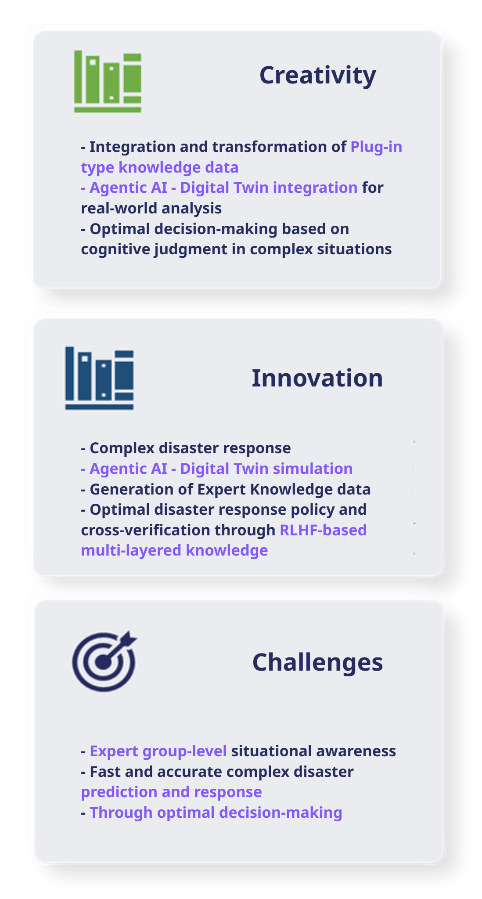
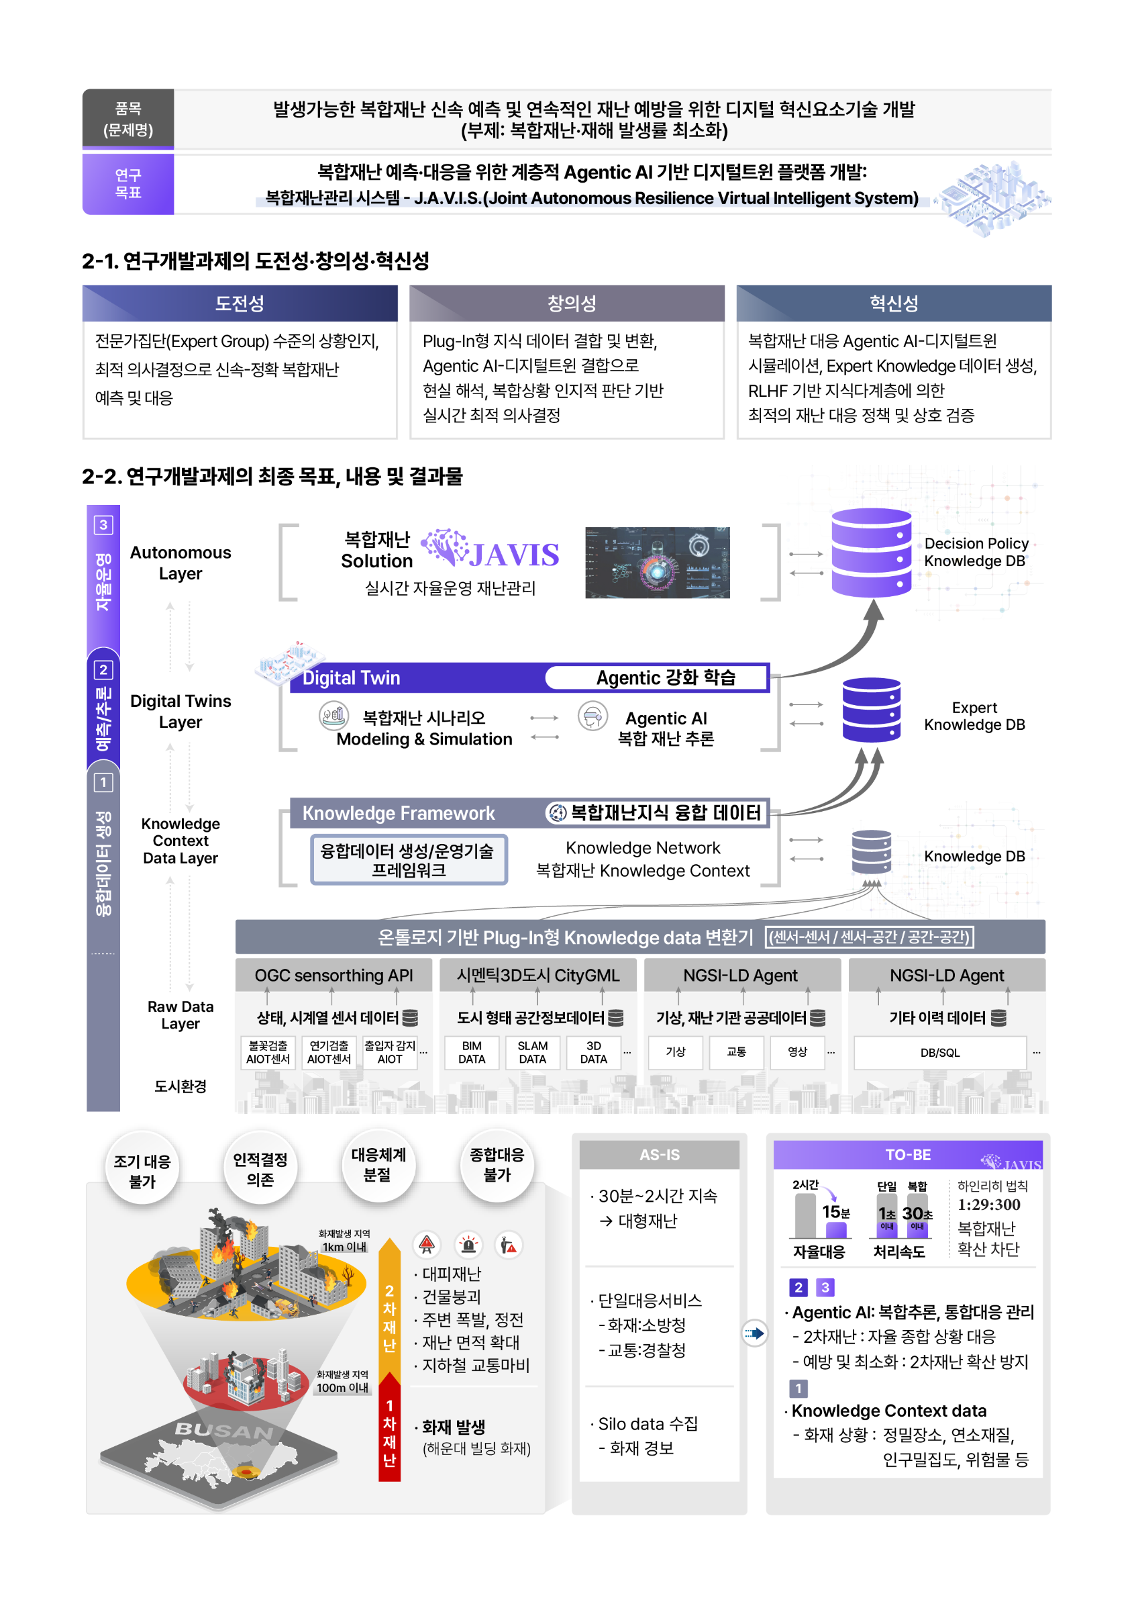
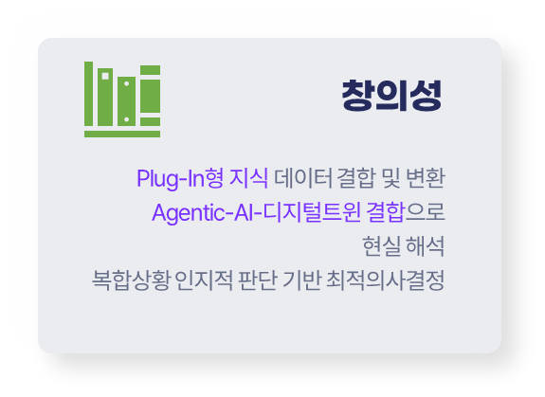
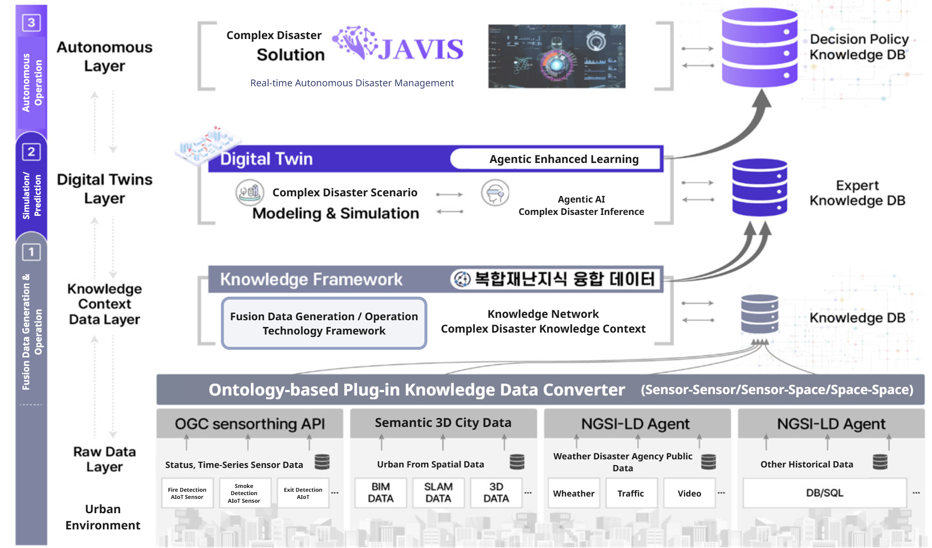
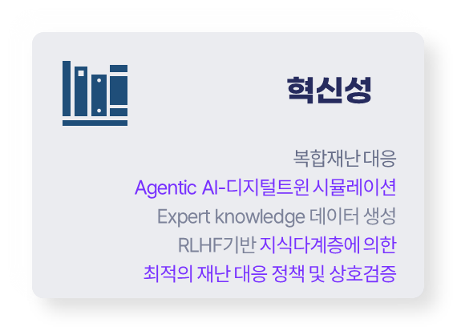

02
Goals and Content of R&D Project
복합재난 예측∙대응을 위한 계층적 Agentic AI 기반
디지털 트윈 플랫폼 개발
Objectives
Development of a hierarchical agentic AI - digital twin platform for complex disaster prediction and response
Complex Disaster Management System -JAVIS(Joint Autonomous Resilience Virtual Intelligent System)
As-IS

Slide 13
Autonomous Layer
Autonomous Collaborative Intelligence & Verification
Autonomous Cognitive Response
MoE RLHF/GRPO
Autonomous Verification System
Autonomous Disaster Management
Complex Disaster/Environment Cognition, PPO/DPO/GRPO,
Semantic Collaboration and Mutual Response
Synthetic Dataset Verification
Multi-Source Learning Model
Verification
Autonomous Collaborative Simulation & Verification
Collaborative AI Agent Learning
Knowledge + Knowledge Combination
Autonomous Cognition, Verification, Evaluation
Simulation Generation Layer
Collaborative Layer
Distributed Multiple AI Agents for Realtime Prediction
(Multi-Agent AI Orchestrator)
Mult-Agent Inference
Context Aware Inference
Knowledge DB
Large Model (LCM/LAM/LWM)
Simulation
Hierarchical semantic realtime AI prediction
AI Agents : Composite/Spatial Inference & Human Agent
Hosting & 3D Tiling
Realtime Web Visualization
Physical Engine based Simulation
Context Aware Complex Disaster Ontology Learning
Meta Knowledge
LAM & LWM Model
Spatial-Human Composite Task
Machine + Machine Combination
Knowledge Inference / Learning
Gen AI ; Complex Multimodal data generation
Knowledge Context DB
Knowledge Layer
Knowledge Context Framework
Context Awareness Knowledge
BigData Context Analysis
Knowledge Context Broker
NGSI-LD
Sensor/3D Scene Graph
Graph based Streaming
LLM/LMM Model Inference
GeoSPARQL OWL, RDF
Scene Graph DB
Neo4J / RAG/TAG
SLAM-BIM 3D City Model
Synthetic Data Multimodal Dataset
Semantic Sensor-Geospatial
Sensor + Sensor / Spatial + Spatial Combination
Integrated Ontologies of Sensor & 3D City Model
Spatial/Sensor/Human Data DB
Data Layer
Open Standardization
Sensor/Spatial Data
Physical Layer
Smart City Living Lab
Semantic 3D City DB
AIoT Sensor Meta DB
Single AI Learning Model DB
Semantic 3D CItyModel
(CityGML)
Sensing (inference) Data
(OGC Sensorthings API)
Sensor/
Spatial Information
AIoT Sensing System
Single Task AI Base Model
Task Meta Modeling (*Object: (Type, Environment, Human)

Slide 14
02
Goals and Content of R&D Project
2-2
Goals, Objectives, and Outcomes of the R&D Project
Strategies
Agentic AI-powered Digital Twin Platform
Digital
Twin
Digital Twin
Simulation
1st Disaster
event
Disaster
Forecasting
Autonomous
Respone
Pre-disaster
Subway Fire
Fire/Collapse/Explosion
Initial Respone
Always-on Virtual Simulation
Converged Data Generation
Knowledgeization/AI inference learning
Autonomous Response Validation
Fire AIoT Sensor
Multi AIoT Sensor
Meta-Analysis
(Building, Roads, Subways, etc…)
Knowledge Layer
Specific Disaster/Spatial/Human Combining Contextual Knowledge
AI Inference Layer
Complex disaster forecasting
Autonomous Respone Layer
Expert-lelve respone policies
Semantic-based collaboration
Mutual aid and preparedness path
Mutual respone by partner organizations
Always on
_{dectection within}
1s
_{prediction within}
30s
_{respone within}
15m

Slide 15
02
Goals and Content of R&D Project
복합재난 예측∙대응을 위한 계층적 Agentic AI 기반
디지털 트윈 플랫폼 개발
2-3
Phased goads, content, and deliverable for R&D Project
Phase 1 (Year 1~2) : Knowledge-based complex disaster reference modeling and JAVIS prototype development
1
Knowledge-based
Complex disaster fusion data modeling
Disaster Interconnectivity: Semantic Spaces – Informing Sensor-based Knowledge
Deliveriables
[Data Layer]
Modeling data type by disaster type including sensors, 3D city, public, historical information etc.
Multi-srouce fusion data reference model training
[Knowledge Context Layer]
Developing ontology-based plugin Knowledge data converters and real time data processing models based on Knowledge Graph
[Complex Disaster Space-Sensor Data Modeling]
Digital Twin-based Complex Disaster Fusion Data reference model 2 or more
At least 2 knowledge-based multi-source complex disaster datasests
Space-Sensor
AI Models
Multi-model Generative mdoel (NIM, NeMO)
Multi-source Fusion
Create synthetic data
CityGML
Sensorthings API
Disaster type
Meta-definitions
[Complex Disaster Space-Sensor Knowledge Informationzation
Space-Sensor Integration Ontology and Complex Disaster Knowledge Graph
Knowledge Context Broker and Context Interpretation

Slide 16
02
Goals and Content of R&D Project
복합재난 예측∙대응을 위한 계층적 Agentic AI 기반
디지털 트윈 플랫폼 개발
2-3
Phased goads, content, and deliverable for R&D Project
Phase 1 (Year 1~2) : Knowledge-based complex disaster reference modeling and JAVIS prototype development
2
Agentic AI-Digital Twin
Prototype Development
Complex disaster prediction and simulation prototype
Deliveriables
[Multi AI Agent Orchestrator Prototype]
[Digital Twin Layer]
Development of Multi Agent Orchestrator and Expert Knowledge Prototype
3D city model/complex sensor data/visualization platform development
Agentic AI- Digital Twin
Prototype
Multi AI Agents : Complex Disaster, Spatial Cognition, Human Cognition
Multi-Agent-based Complex Disaster Cognitive Reasoning
Designing Expert Knowledge Abstraction
Multi Agent Orchestrator (Magentic-One etc)
[Complex Disaster Simulation]
Speed of Complex Catastrophe Inference
Less than 2 minutes
Data Platform (Fiware)
Visualizaiton (Omniverse, Cosmos, etc.) engines
Knowledge-based Reference Simulations

Slide 17
02
Goals and Content of R&D Project
복합재난 예측∙대응을 위한 계층적 Agentic AI 기반
디지털 트윈 플랫폼 개발
2-3
Phased goads, content, and deliverable for R&D Project
Phase 1 (Year 1~2) : Knowledge-based complex disaster reference modeling and JAVIS prototype development
3
Collaborative Intelligent Complex Disaster Autonomous Digital Twin Prototype
JAVIS Prototype Development
Deliveriables
[Collaboration Intelligence - Expert Group Policy]
JAVIS Prototype
[Autonomous Layer]
Development of JAVIS (Real-time Collaborative Intelligent Autonomous Digital Twin) Prototype through Expert Group Policy Model Learning Based on Smart City Complex Disaster Scenario
LLM/LMM-based complex decision-making and execution strategies
Expert Group Policy model based on RLHF PPO / DPO
Field Demonstrations
(Smart Cities - fire/gas, underground flooding, etc.)
[Autonomous verification and response]
40% more automated complex disaster decision-making
Complex disasters on the digital twin Establish type-specific self-validation
Field Test the Multi-Disaster Reference Model

Slide 18
02
Goals and Content of R&D Project
복합재난 예측∙대응을 위한 계층적 Agentic AI 기반
디지털 트윈 플랫폼 개발
2-3
Phased goads, content, and deliverable for R&D Project
Phase 2 (Years 3~4) : Establish JAVIS Complex Disaster Prediction and Autonomous Response System based on Empirical Scenarios
1
Expert Knowledge Base Complex Disaster Fusion Data Creation Technology
Expert-level complex disaster knowledge network framework
Deliveriables
[Expert Knowledge Base Create Complex Disaster Fusion Data]
Digital Twin-based Complex Disaster Fusion Data Reference Model 2 or more
Environmental cognitive multi-source composite 2 or more disaster datasets
[Data Layer]
Automated construction of SLAM-BIM-based 3D city model environments and generation of expert knowledge-based complex disaster fusion datasets
[Knowledge Context Layer]
Build an expert-level Knowledge Network framework
SLAM-BIM - CItyGML Automatically Generate 3D Spatial Environments
Create an Environmental Cognitive Complex Disaster Multimodal Dataset
Complex Environments: Local, Spatial, and Multi-Sensor
[Expert Knowledge Network Framework]
Deploy Expert Semantic Web
Expert Knowledge Graph Model

Slide 19
02
Goals and Content of R&D Project
복합재난 예측∙대응을 위한 계층적 Agentic AI 기반
디지털 트윈 플랫폼 개발
2-3
Phased goads, content, and deliverable for R&D Project
Phase 2 (Years 3~4) : Establish JAVIS Complex Disaster Prediction and Autonomous Response System based on Empirical Scenarios
2
Multi-Agent Based Complex disaster AI predictive technology
Multi-Agent Complex Disaster Prediction and Demonstration Scenario-Based Simulation
Deliveriables
[Multi Agent Orchestrator Complex Catastrophe Inference]
[Demonstration Scenario] Initial detection within 10s FAR within 10%
[Digital Twin Layer]
Development of Complex disaster mutual ontology,
Physical AI engine-based complex disaster simulation, Expert Knowledge graph model-based
Hierarchical Multi Agent Orchestrator Development and complex disaster reasoning
LLM/LMM-based Complex Disasters Expert Knowledge Graph
Real-time complex disaster situational awareness reasoning with Causal Reasoning
Speed of Complex Catastrophe InferenceLess than 1 minute
[Complex Disaster Demonstration Simulation]
Virtual simulation of complex disasters powered by a physics AI engine
Early detection and response based on empirical scenarios
Genesis, COSMOS WFM, etc.; simulate fire/gas/flooding, etc.

Slide 20
02
Goals and Content of R&D Project
복합재난 예측∙대응을 위한 계층적 Agentic AI 기반
디지털 트윈 플랫폼 개발
2-3
Phased goads, content, and deliverable for R&D Project
Phase 2 (Years 3~4) : Establish JAVIS Complex Disaster Prediction and Autonomous Response System based on Empirical Scenarios
3
Collaborative Intelligence Complex Disaster Autonomous Digital Twin Testing
JAVIS Autonomous Operations Testing
Deliveriables
[Collaboration Intelligence - Expert Group Policy]
[Demonstration Scenario] Initial disaster response time 30 minutes or less
[Autonomous Layer]
Industrial Park Complex Catastrophe Scenario Based Expert Group Policy Network Enforcement
JAVIS Autonomous Operations Testing and Modernization
Deploy Expert Group Policy based on LLM/LMM , RLHF
Understanding the complex disaster context and mutual self-regulation
[Autonomous verification and response]
Over 60% automation of complex disaster decision-making
Digital Twin Complex Disasters Advancing Autonomous Operations
Simulate complex disaster response and field testing
※ Complex disasters for industrial complexes or smart cities (fire/gas, flooding, etc.)

Slide 21
02
Goals and Content of R&D Project
복합재난 예측∙대응을 위한 계층적 Agentic AI 기반
디지털 트윈 플랫폼 개발
2-3
Phased goads, content, and deliverable for R&D Project
Phase 3 (Years 5-8): Demonstration of complex disaster prediction and autonomous operation based on JAVIS, a complex disaster management system
1
Expert Knowledge Base Automatically Generate Complex Disaster Fusion Data
Large-scale complex disaster physical world model LWM and multimodal Gen AI
Deliveriables
[LWM-based complex disaster generation]
Spatial Knowledge Multimodal AI Models 6 or more
Expert multi-source complex disaster datasets 6 or more
[Data Layer]
Expert Knowledge-based Complex Environments Automatically generate complex disaster fusion datasets and train spatially knowledgeable multimodal AI dictionary models
[Knowledge Context Layer]
Expert Knowledge network-based disaster correlation Automated generation of Expert Knowledge contexts
Large Complex Disaster Physical World Model (LWM) and Expertise Building
Automatically Generate Complex Environment Complex Disaster Synthetic Data
※ LWM-based multimodal inference model learning, physical simulation, and contextual adaptation
[LCM-based Expert Knowledge Context]
Automatically generate Expert Knowledge Contexts based on large semantic models (LCMs)
Expert Knowledge Context-based disaster interconnection semantics

Slide 22
02
Goals and Content of R&D Project
복합재난 예측∙대응을 위한 계층적 Agentic AI 기반
디지털 트윈 플랫폼 개발
2-3
Phased goads, content, and deliverable for R&D Project
Phase 3 (Years 5-8): Demonstration of complex disaster prediction and autonomous operation based on JAVIS, a complex disaster management system
2
Powered by Agentic AI Reinforcement Learning Real-time complex disaster prediction
Agentic AI early detection of complex disasters
Deliveriables
[Agentic AI Complex Catastrophe Reasoning]
Complex disaster initial detection within 1s to 10s
Within 5% of FAR
[Digital Twin Layer]
Hierarchical Multi Agent Orchestrator based disaster correlation meta-analysis, based on Agentic AI reinforcement learning Complex disaster simulation and inference model validation, real-time complex disaster early prediction
Based on a large-scale behavioral model (LAM)Collaborative Complex Disaster Expertise
Distributed Multi-Agent Reinforcement Learning for Real-Time Complex Disaster Situation Cognitive Reasoning
[Agentic AI Complex Disaster Demonstration Simulation]
Speed of Complex Catastrophe Inference 30 seconds or less
Response virtual simulation powered by Agentic AI and Physical AI engines
Real-time early detection and response to complex disasters based on empirical scenarios
Genesis, COSMOS WFM, and more; urban-combined-disaster-crowd-response virtual simulation

Slide 23
02
Goals and Content of R&D Project
복합재난 예측∙대응을 위한 계층적 Agentic AI 기반
디지털 트윈 플랫폼 개발
2-3
Phased goads, content, and deliverable for R&D Project
Phase 3 (Years 5-8): Demonstration of complex disaster prediction and autonomous operation based on JAVIS, a complex disaster management system
3
JAVIS Autonomous Operations Validation
Collaborative Intelligence Complex Disaster Autonomous Digital Twin Operations
Deliveriables
[Collaboration Intelligence - Expert Group Policy]
[Autonomous Layer]
Maritime Urban Complex Disaster Scenario Expert Group Policy Knowledge Demonstration JAVIS real-time complex disaster response operation and verification/evaluation system operation
Initial Complex Disaster Response Time Within 15 to 30 minutes
Large AI Model Expert Group Policy Knowledge Verification
Autonomous Collaboration Expert Knowledge Interoperability
Large-scale AI model for complex disasters (LCM,LAM,LWM)
[Autonomous verification and response]
Over 95% automation of complex disaster decision-making
Digital Twin Complex Disasters Autonomous operations and response, verification/assessment
Real-Time Complex Disaster Response Field Validation
Multi-disaster (weather, building, underground) for maritime megacities

Slide 24
02
Goals and Content of R&D Project
복합재난 예측∙대응을 위한 계층적 Agentic AI 기반
디지털 트윈 플랫폼 개발
2-3
Phased goads, content, and deliverable for R&D Project
10
Multi-Source Complex Disaster Dataset
1 s /30 s
Complex disaster data processing speed
Composite Disaster (Real+Virtual) Dataset Types
AIoT single sensor (1 second) / complex data processing (30 seconds)
95 %
Complex Catastrophe Prediction Model Accuracy
15 m less
Complex disaster initial disaster response time
Complex environment and complex disaster forecast model accuracy (FRA within 5%)
(Self-validation - disaster response) Response time
1K
95 %
Level of automation for complex disaster decision-making
Number of concurrent AI agents
Concurrent processing of agents on Multi AI Agents Orchestrator
Decision automation ratio (number of AI Agent decisions / total number of decisions)x100
JAVIS Complex Disaster Autonomous Response - 1:29:300law Rule of Thumb Detected within 10 seconds, initial response completed within 15 minutes

Slide 25
03
Strategies, methods, and implementation systems for R&D projects
JAVIS Complex Disaster Autonomous Response- 1:29:300 Rule Detected within 10 seconds, initial response completed within 15 minutes

Slide 26
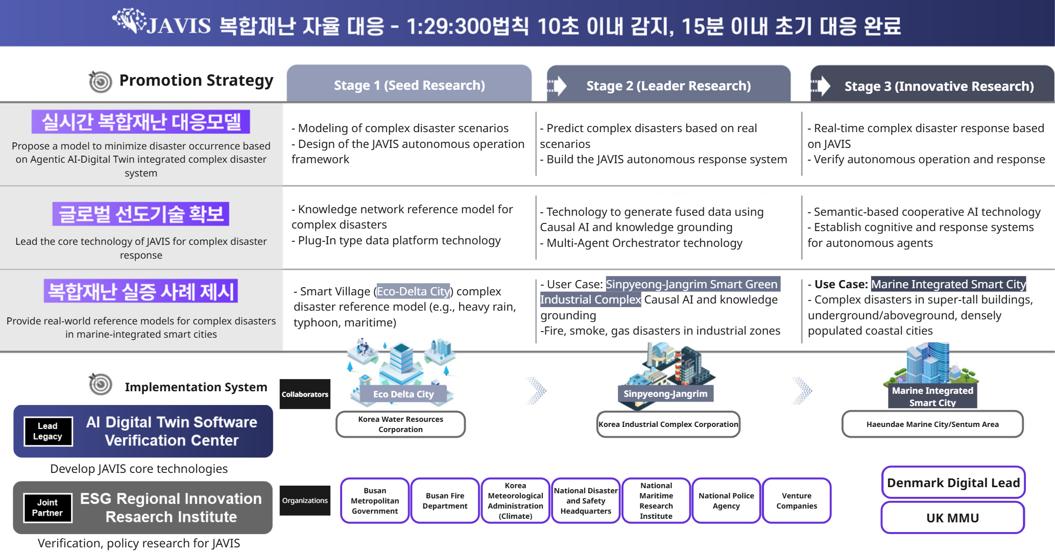
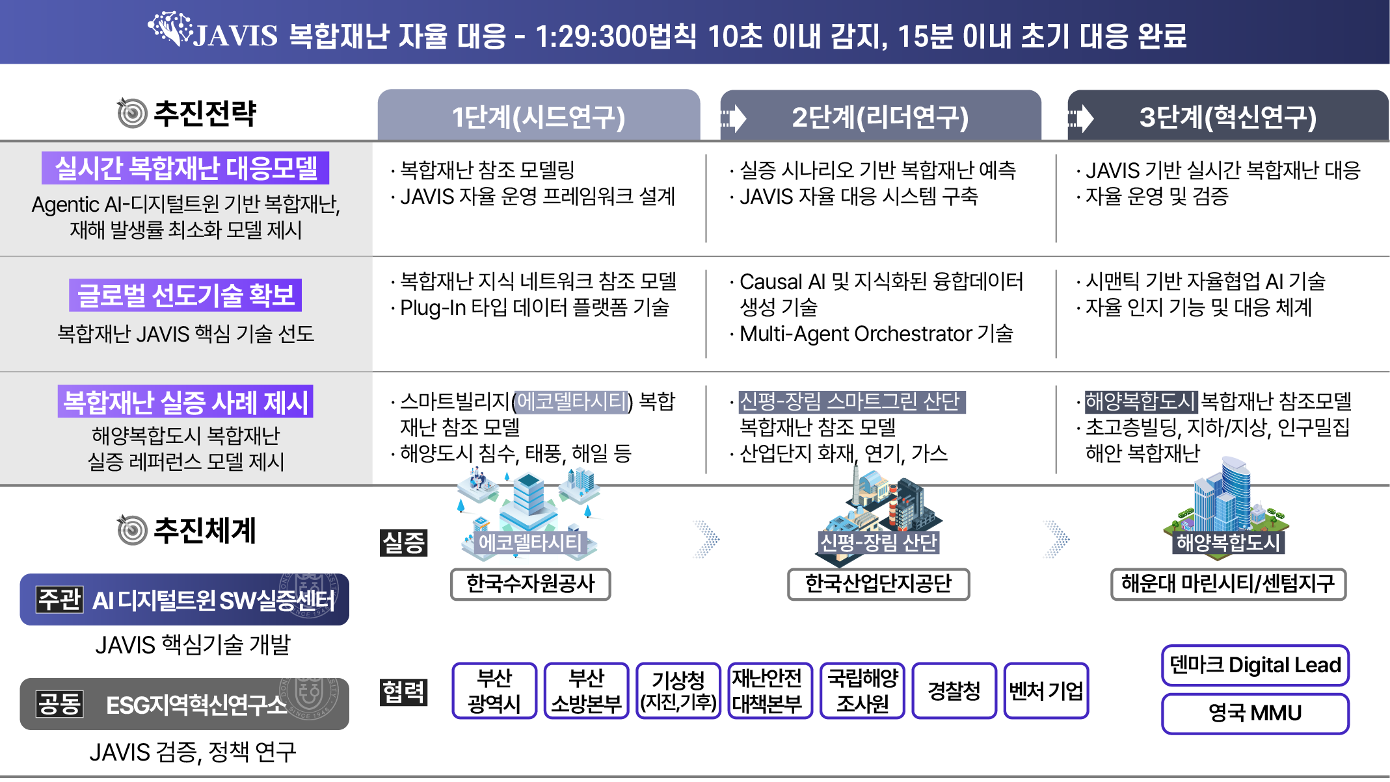

03
Strategies, methods, and implementation systems for R&D projects
복합재난 예측∙대응을 위한 계층적 Agentic AI 기반
디지털 트윈 플랫폼 개발
JAVIS Autonomous Complex Disaster Response 1:29:300 Rule —
Detect within 10 seconds, complete initial response within 15 minutes
Real-time Complex Disaster Respone Model
Securing Global Leading Technology
Presentation of Real-World Complex Disaster Case Studies

Slide 27
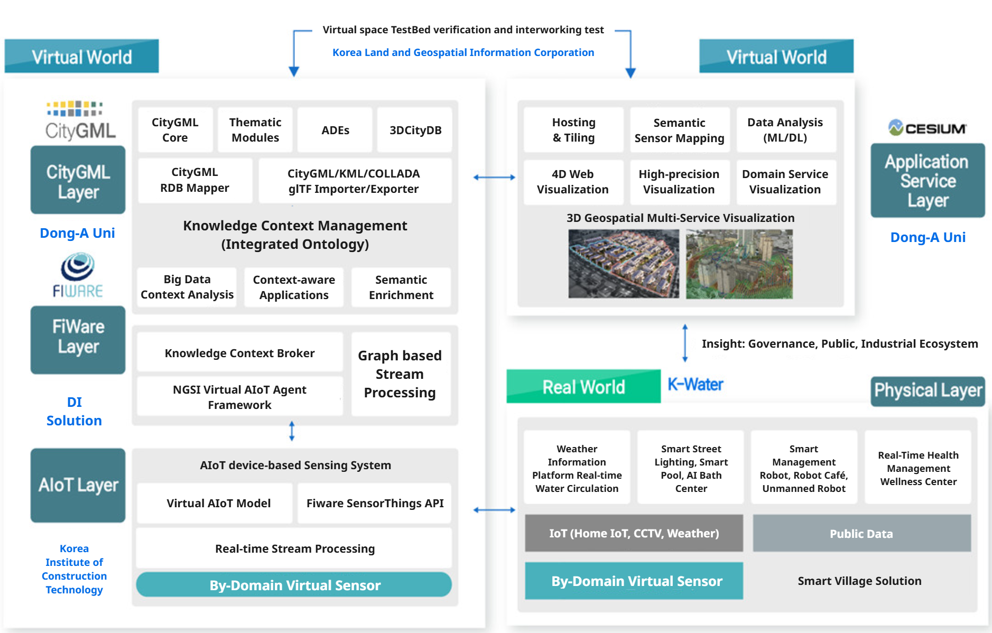
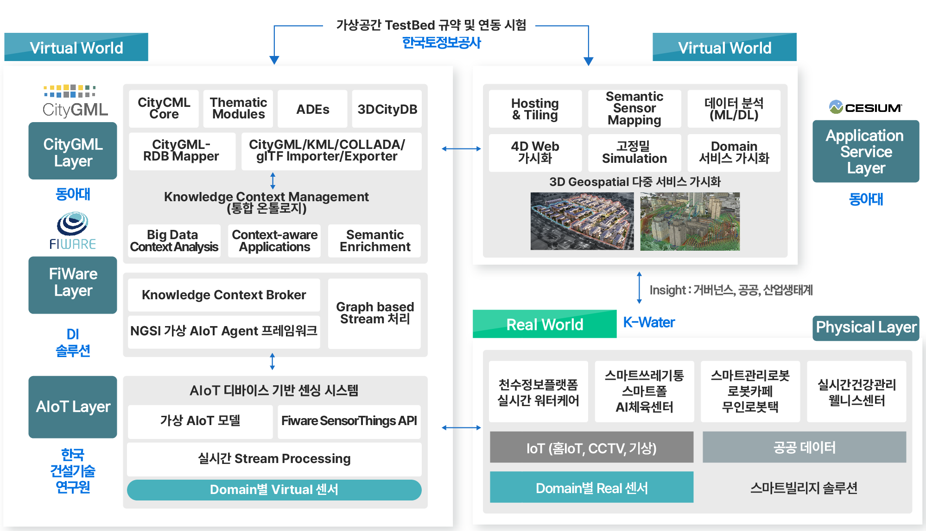
03
Organizer Competencies
Strategies, methods, and implementation systems for R&D projects
복합재난 예측∙대응을 위한 계층적 Agentic AI 기반
디지털 트윈 플랫폼 개발
❶ Establishment of the Digital Twin Testbed
· Ministry of Science and ICT, “Digital Twin-based Smart City Lab Demonstration Complex”
Organized the second part of the project (’22~’25)
· Lead Institution (Dong-A University), Joint Institution (Korea Water Resources Corporation, Korea Institute of Construction Technology, Korea Land Information Corporation, DI Solution)
· Demonstration site: Eco Delta City Smart Village, Smart City Lab
· Development Contents
Smart city data model prototype development
Establishment of AIoT device-based sensing system for each smart city service
Utilizing digital twin-based computing data platform and testbed construction

Slide 28
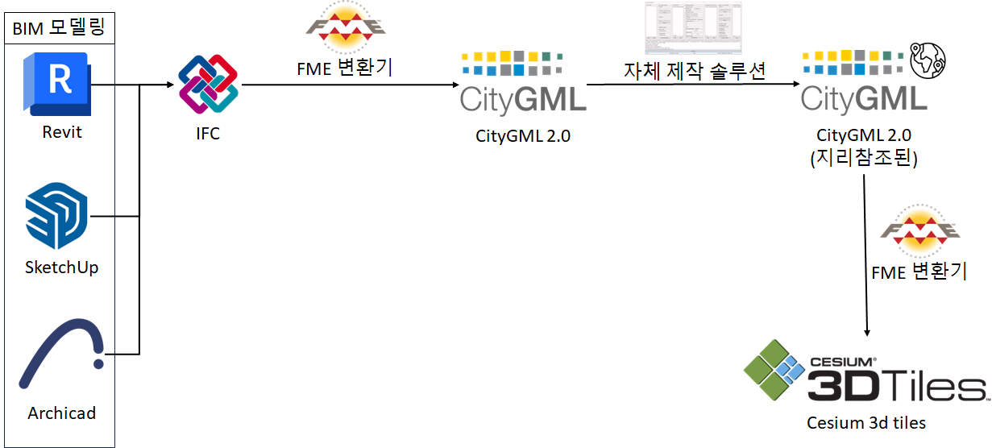
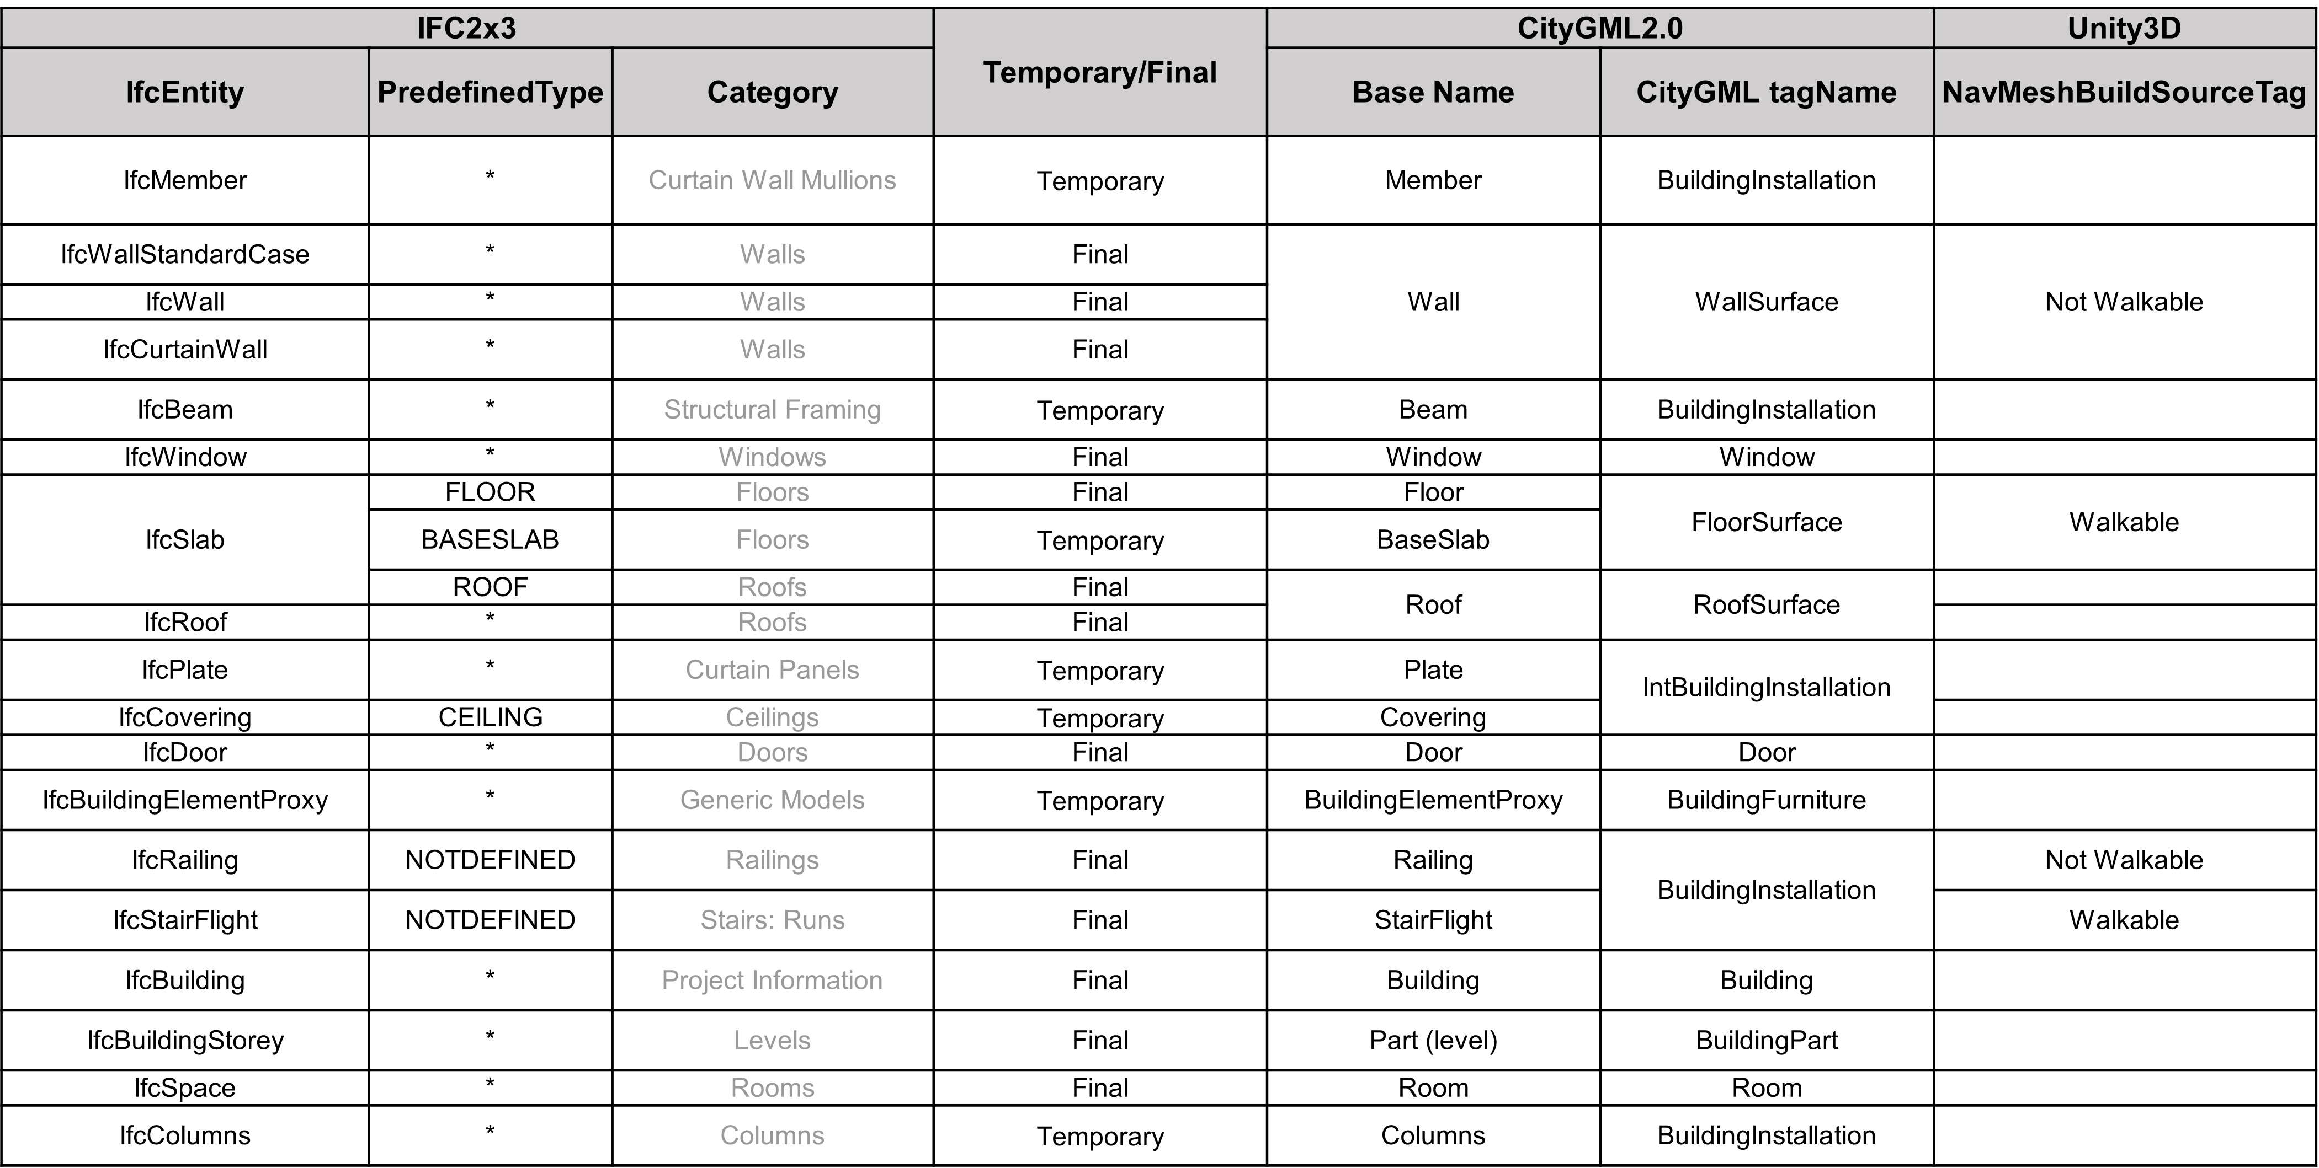
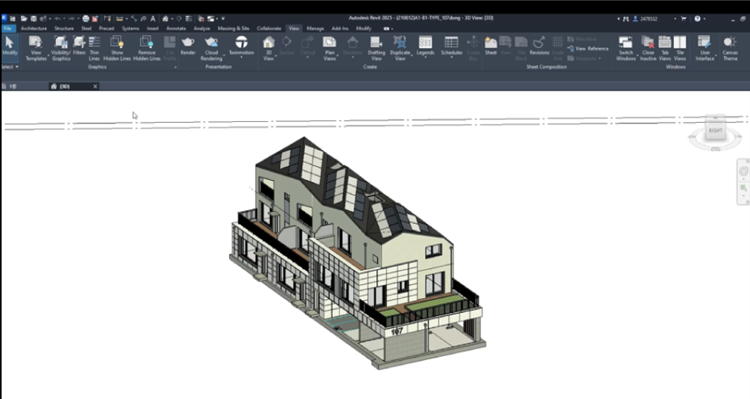
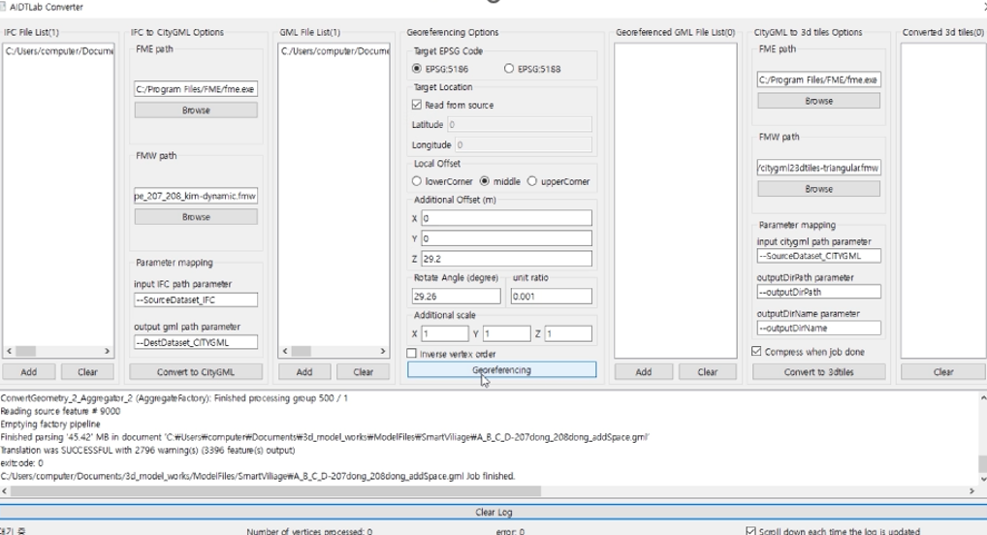
03
Organizer Competencies
Strategies, methods, and implementation systems for R&D projects
복합재난 예측∙대응을 위한 계층적 Agentic AI 기반
디지털 트윈 플랫폼 개발
 Open standard 3D city model building and sensor integration (Smart Village)
Overriding Base Room with Case-Based Mapping Rules for CityGML Inference
Implemented IFC to CityGML to 3DTiles automatic converter

Slide 29
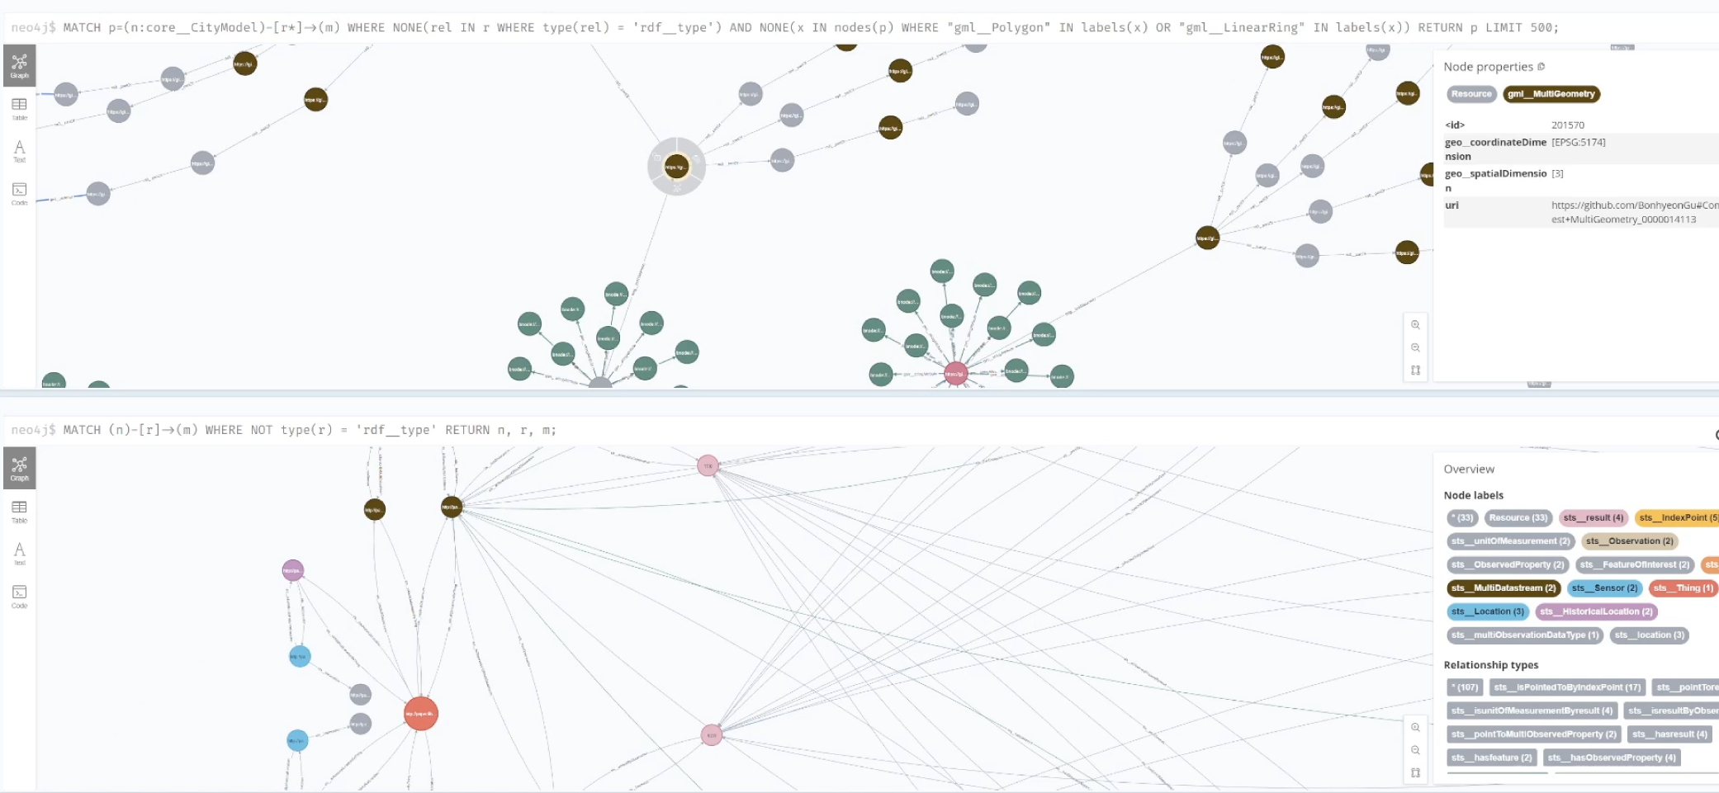
03
Organizer Competencies
Strategies, methods, and implementation systems for R&D projects
복합재난 예측∙대응을 위한 계층적 Agentic AI 기반
디지털 트윈 플랫폼 개발
 Combining spatial data (CityGML) + sensor data (OGC Sensorthing)
Developed Ontology-based (OWL) Knowledge Graph (KG) generator converter (2025)

Slide 30
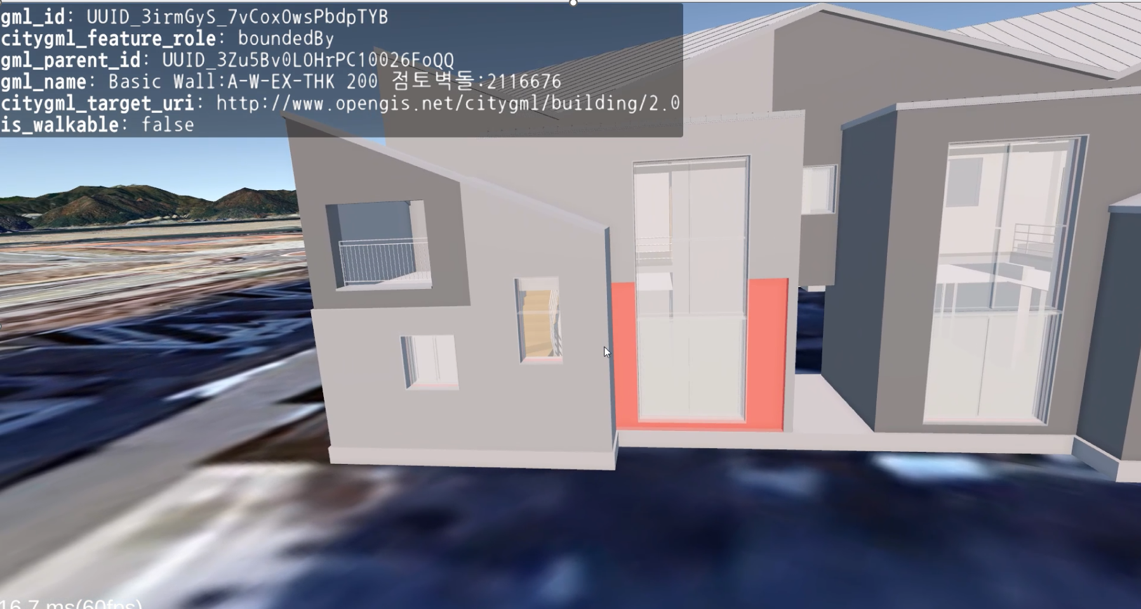
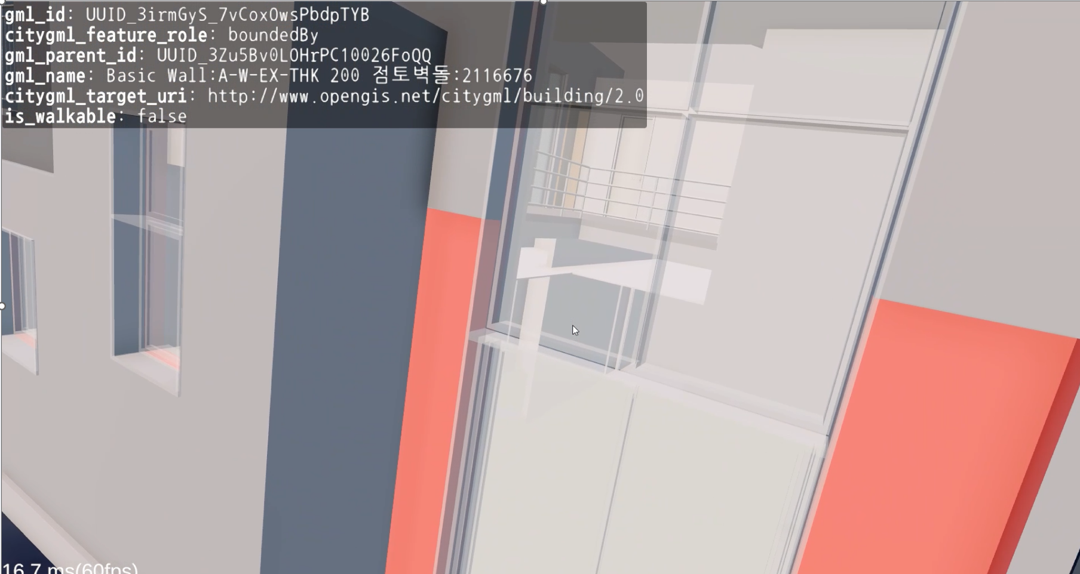
03
Organizer Competencies
Strategies, methods, and implementation systems for R&D projects
복합재난 예측∙대응을 위한 계층적 Agentic AI 기반
디지털 트윈 플랫폼 개발
➍ Develop BIM data management (DB) and visualization platforms
LOD4 level (highest level of detail) metadata results BIM data management (DB) and visualization platform under development (2025)

Slide 31
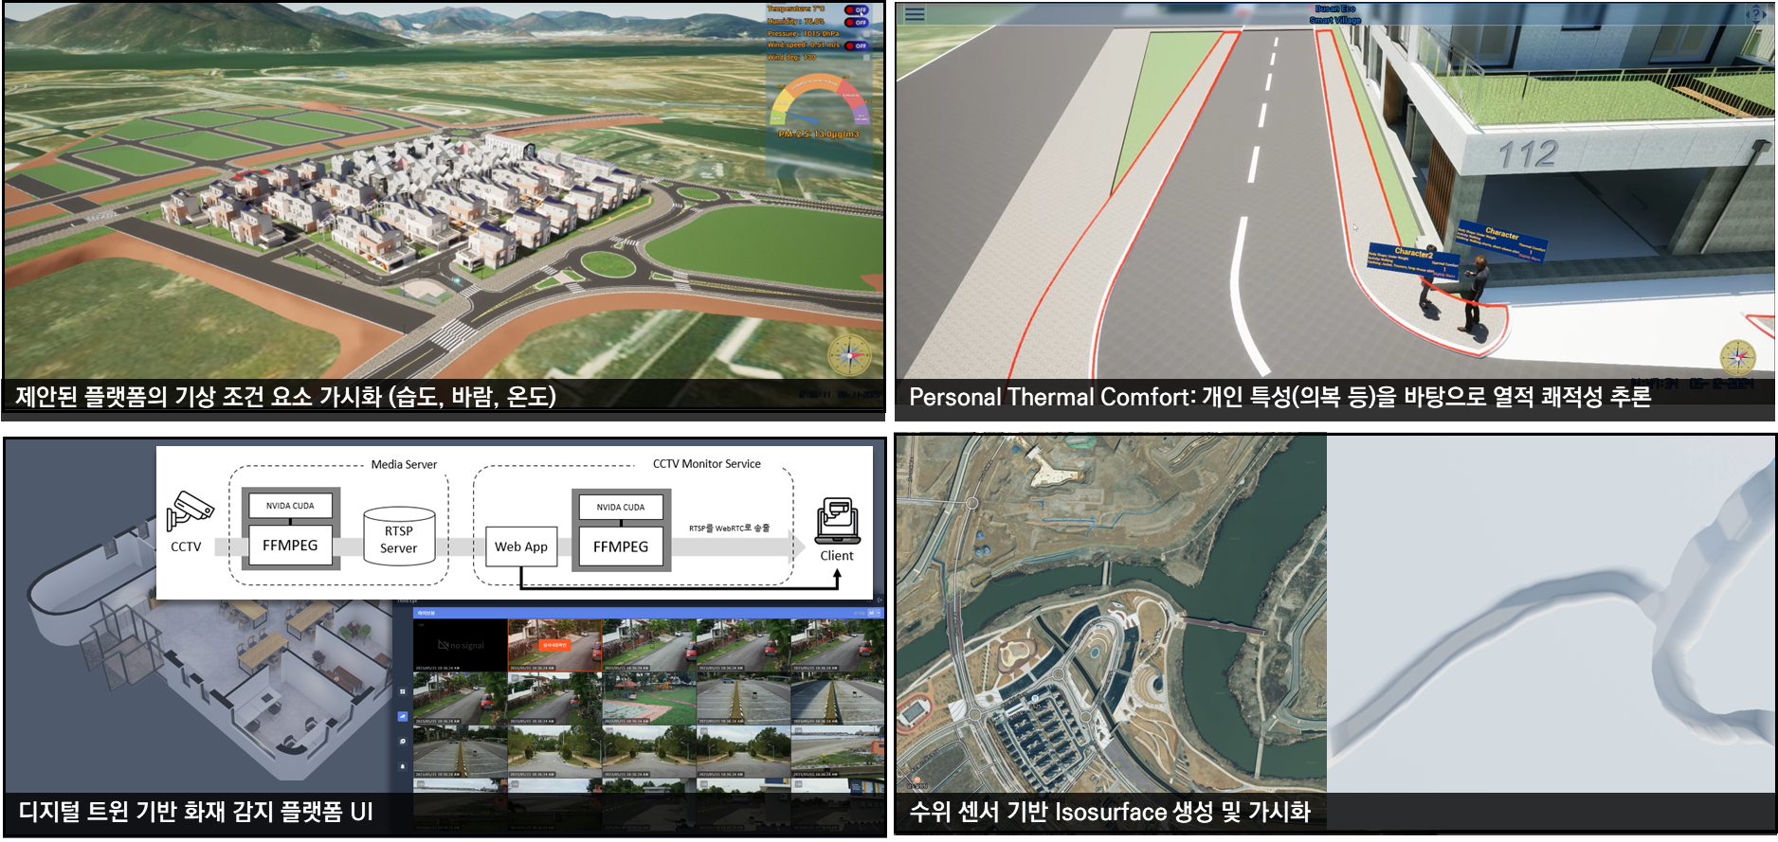
03
Organizer Competencies
Strategies, methods, and implementation systems for R&D projects
복합재난 예측∙대응을 위한 계층적 Agentic AI 기반
디지털 트윈 플랫폼 개발
➎ Connecting Eco Delta City Smart Village: Developing and testing various smart city innovation services based on the Digital Twin platform (Fire, water level, comfort (2025))
Visualization of proposed platform's weather condition elements (humidity, wind, temperature)
Personal Thermal Comfort: Inference of thermal comfort based on personal characteristics (e.g., clothing)
Fire detection platform UI based on digital twin
Generation and visualization of isosurface based on water level sensor

Slide 32
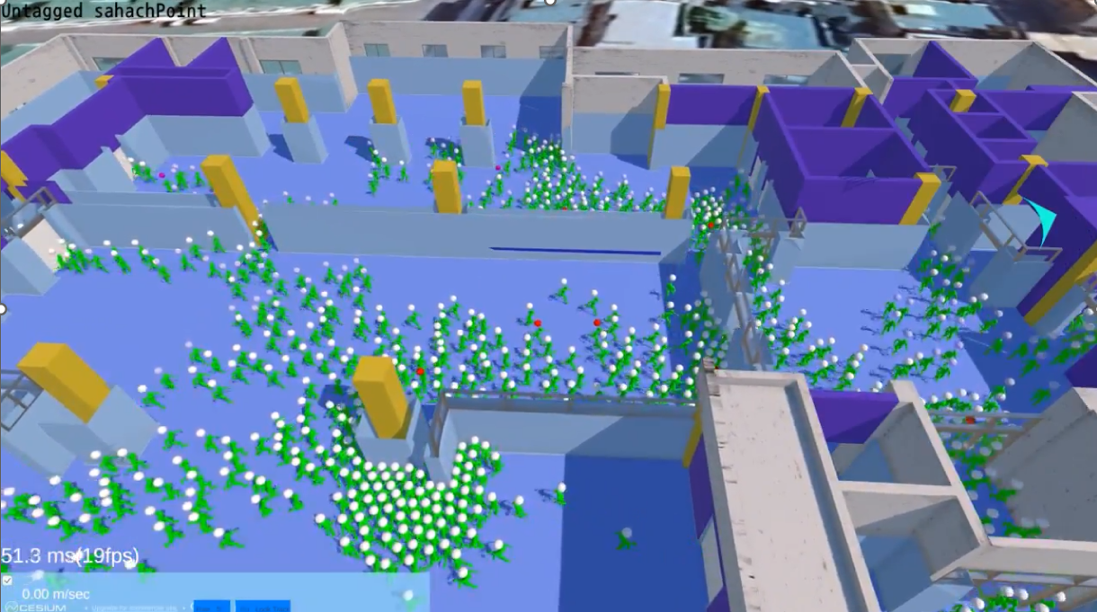
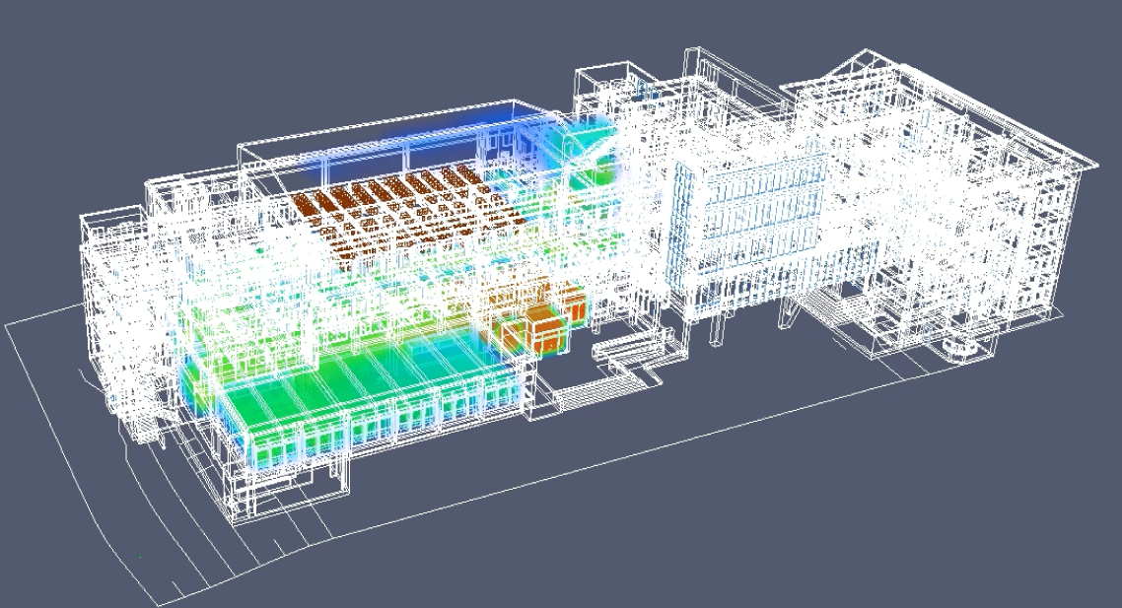
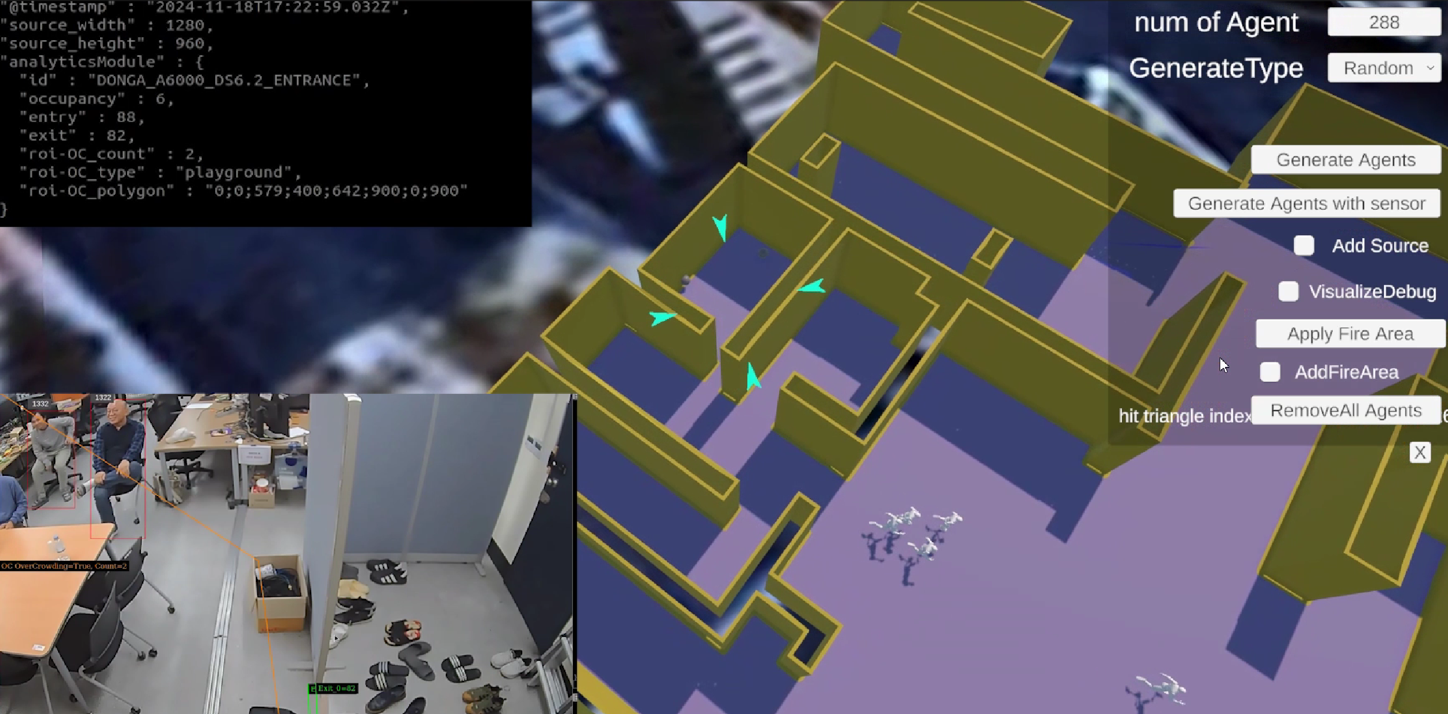
03
Organizer Competencies
Strategies, methods, and implementation systems for R&D projects
복합재난 예측∙대응을 위한 계층적 Agentic AI 기반
디지털 트윈 플랫폼 개발
➎ Demonstration of Saha-gu Office Digital Twin
Saha City Hall digital twin based on standard BIM data
Saha District Office Fire Evacuation Crowd Simulator (In-house Development) 2025 (Normal)
Real-time situational fire evacuation crowd simulator (in-house development)2025 (normal)
Fire (Smoke) Spread Physics Simulation (FDS)

Slide 33
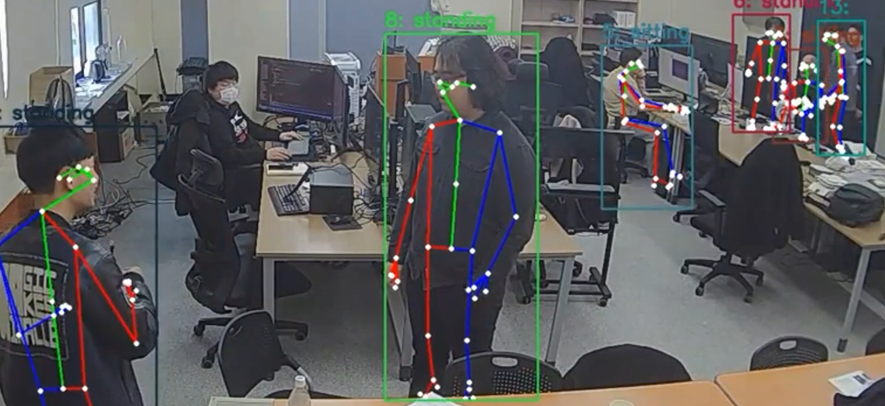
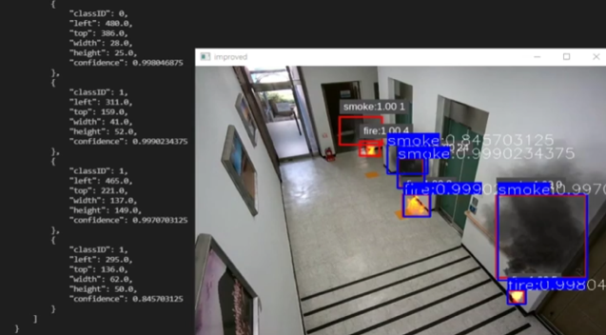
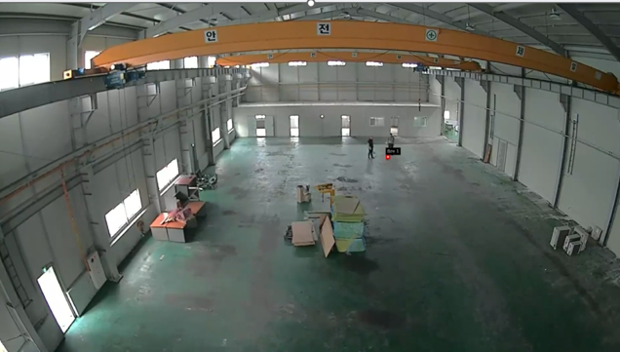
03
Organizer Competencies
Strategies, methods, and implementation systems for R&D projects
복합재난 예측∙대응을 위한 계층적 Agentic AI 기반
디지털 트윈 플랫폼 개발
➏ Acquire high-quality (15-pixel) object detection (fire, smoke, people) AIOT inference engine (AI Sensor) technology
Get high-quality human motion state recognition technology
Saha-gu Office Virtual Fire Simulation (Multimodal Data Generation)
Simulate early fire detection in a factory

Slide 34
04
Appendices
Complex Disaster Project Resources

Slide 35
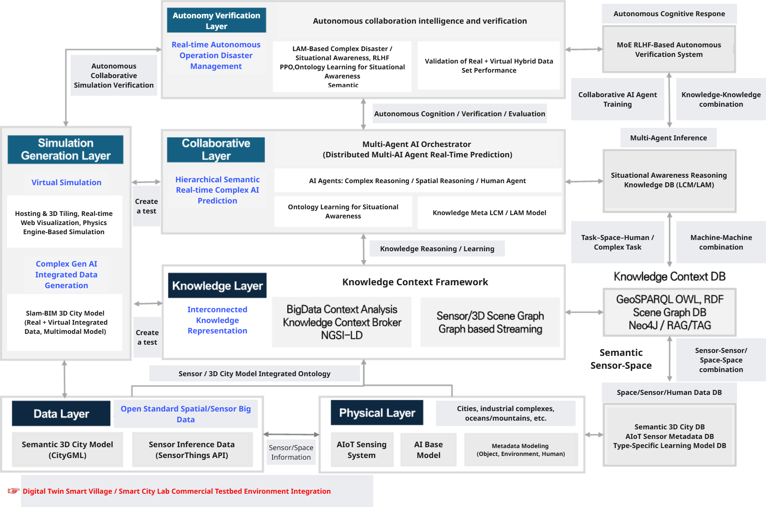
04
참고자료
복합재난 예측∙대응을 위한 계층적 Agentic AI 기반
디지털 트윈 플랫폼 개발

Slide 36
감사합니다
동아대학교 AI·디지털트윈·SW실증센터
동아대학교 ESG지역혁신연구소

